Slide 1
Agriculture and Land-use system
Xin Zhao

Slide 2
Today’s talk
Big pictures of land and agriculture
Data talk
Share a framework/method of analyzing ag & land-use related issues from a modeler’s point of view
Some relevant research questions
How to feed 9 billion people in 2050?
Climate impacts on agriculture & trade as an adaptation
Land-based mitigation measures

Slide 3
Land and how it is used now
US
Earth’s
surface
Land 29% (14.9 Bha)
Ocean 71%
Land
Habitable land (10.6 Bha)
30% Barren & Glaciers & water
Agriculture
5.1 Bha
Nature Forest
3.8 Bha
Other nature
Habitable
Urban & built-up (1%)
Crops
1.6
Grazing
3.2 Bha
Ag-Land
Planted forest (3%)
Ritchie and Roser (2021); gcamdata

Slide 4
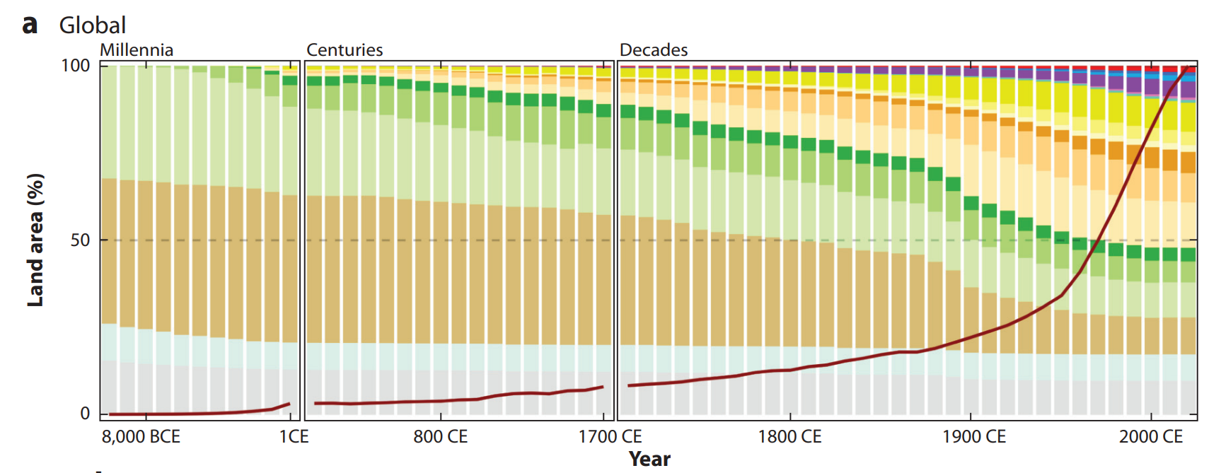
Land use over time: past 12,000 years (HYDE)
1 Bha forest loss
Biodiversity
Water cycle
LUC emissions
Ag-land expansion slows
Ellis (2021); Goldewijk et al. (2017)

Slide 5
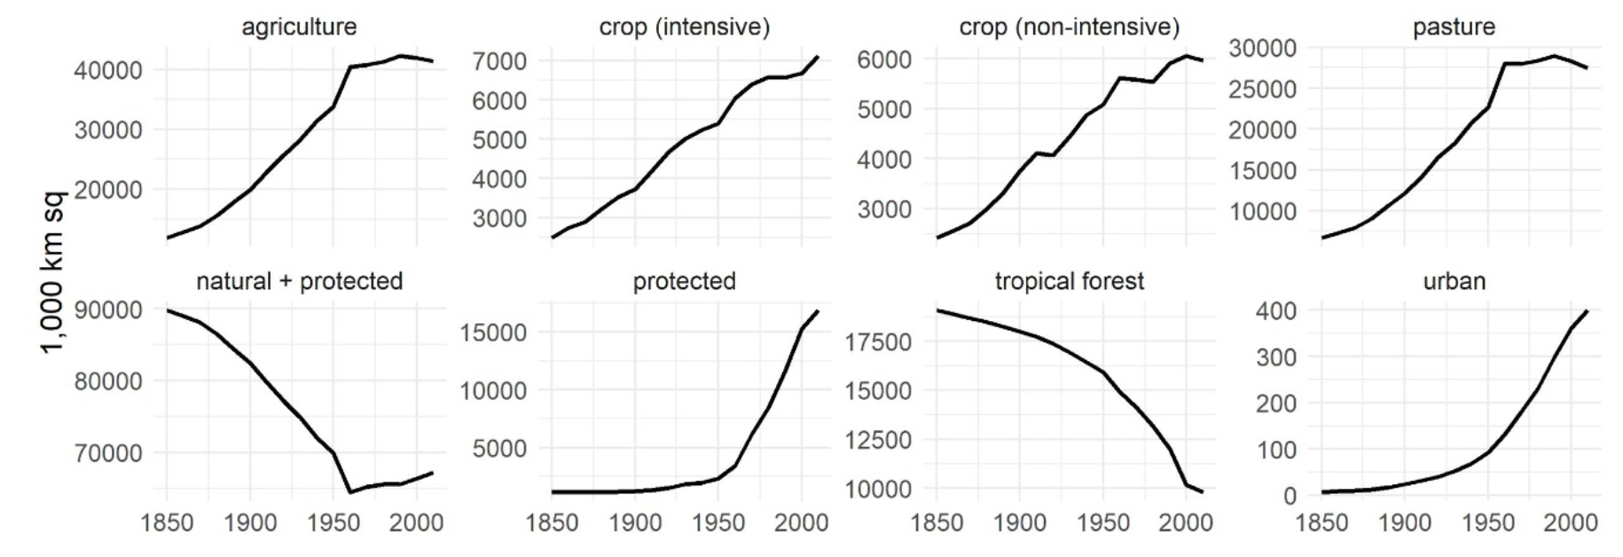
The net total global agricultural land plateaued
subsistence
Taylor and Rising (2021 ERL);

Slide 6
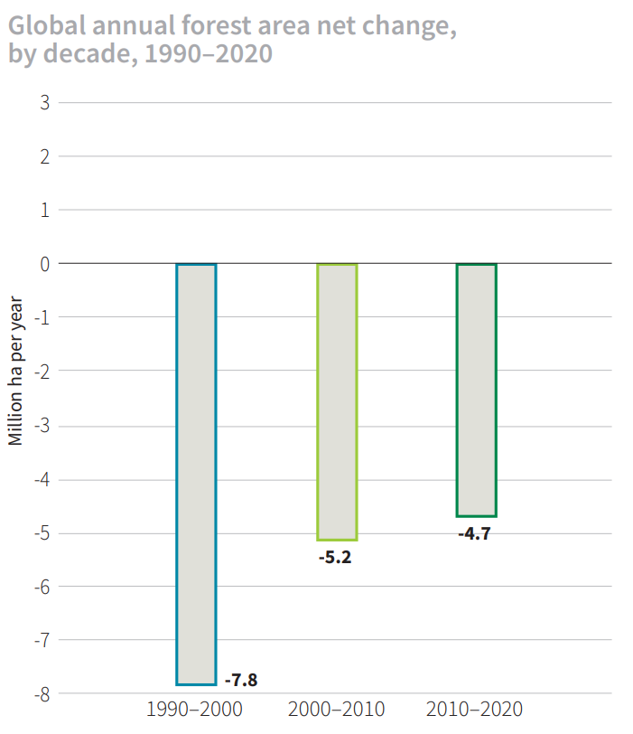
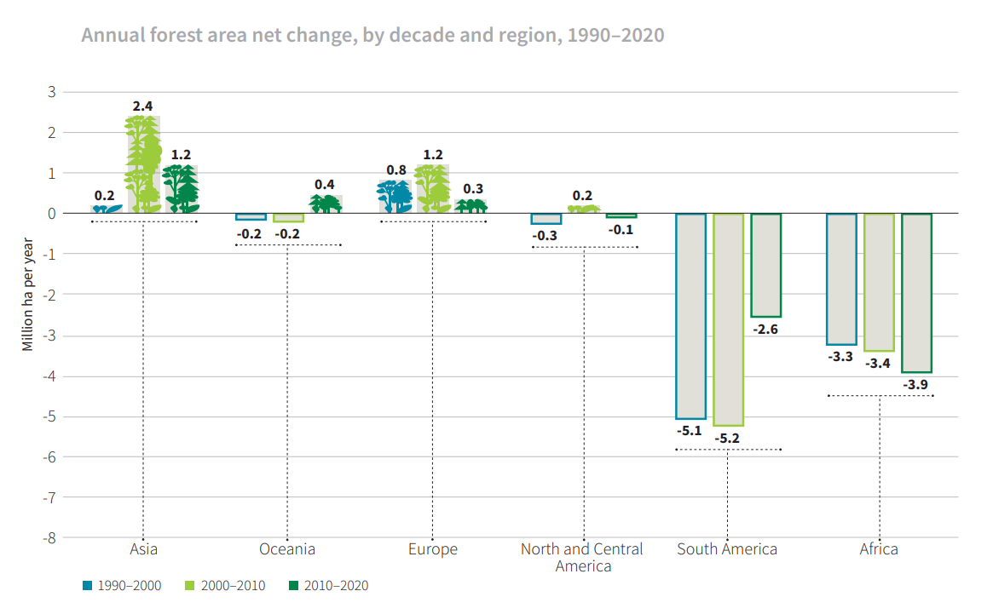
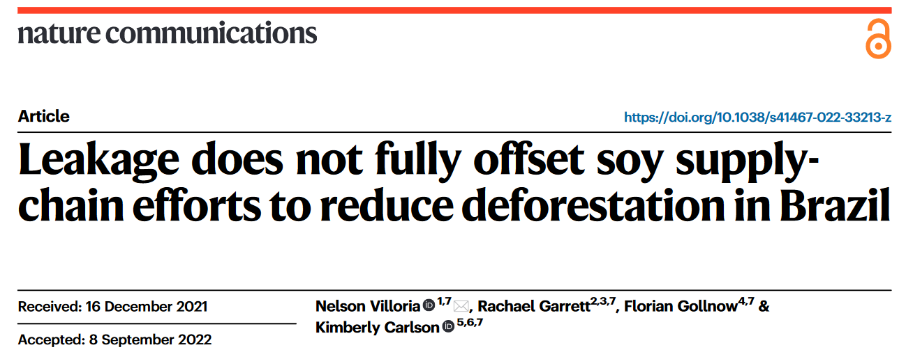
Recent slower global deforestation
Policy intervention
REDD+ (UNFCCC)
Amazon Soy Moratorium
Zero-deforestation supply chain pledge
Trade policies
Leakage?
FRA (2020); Villoria et al. (2022 nc)

Slide 7
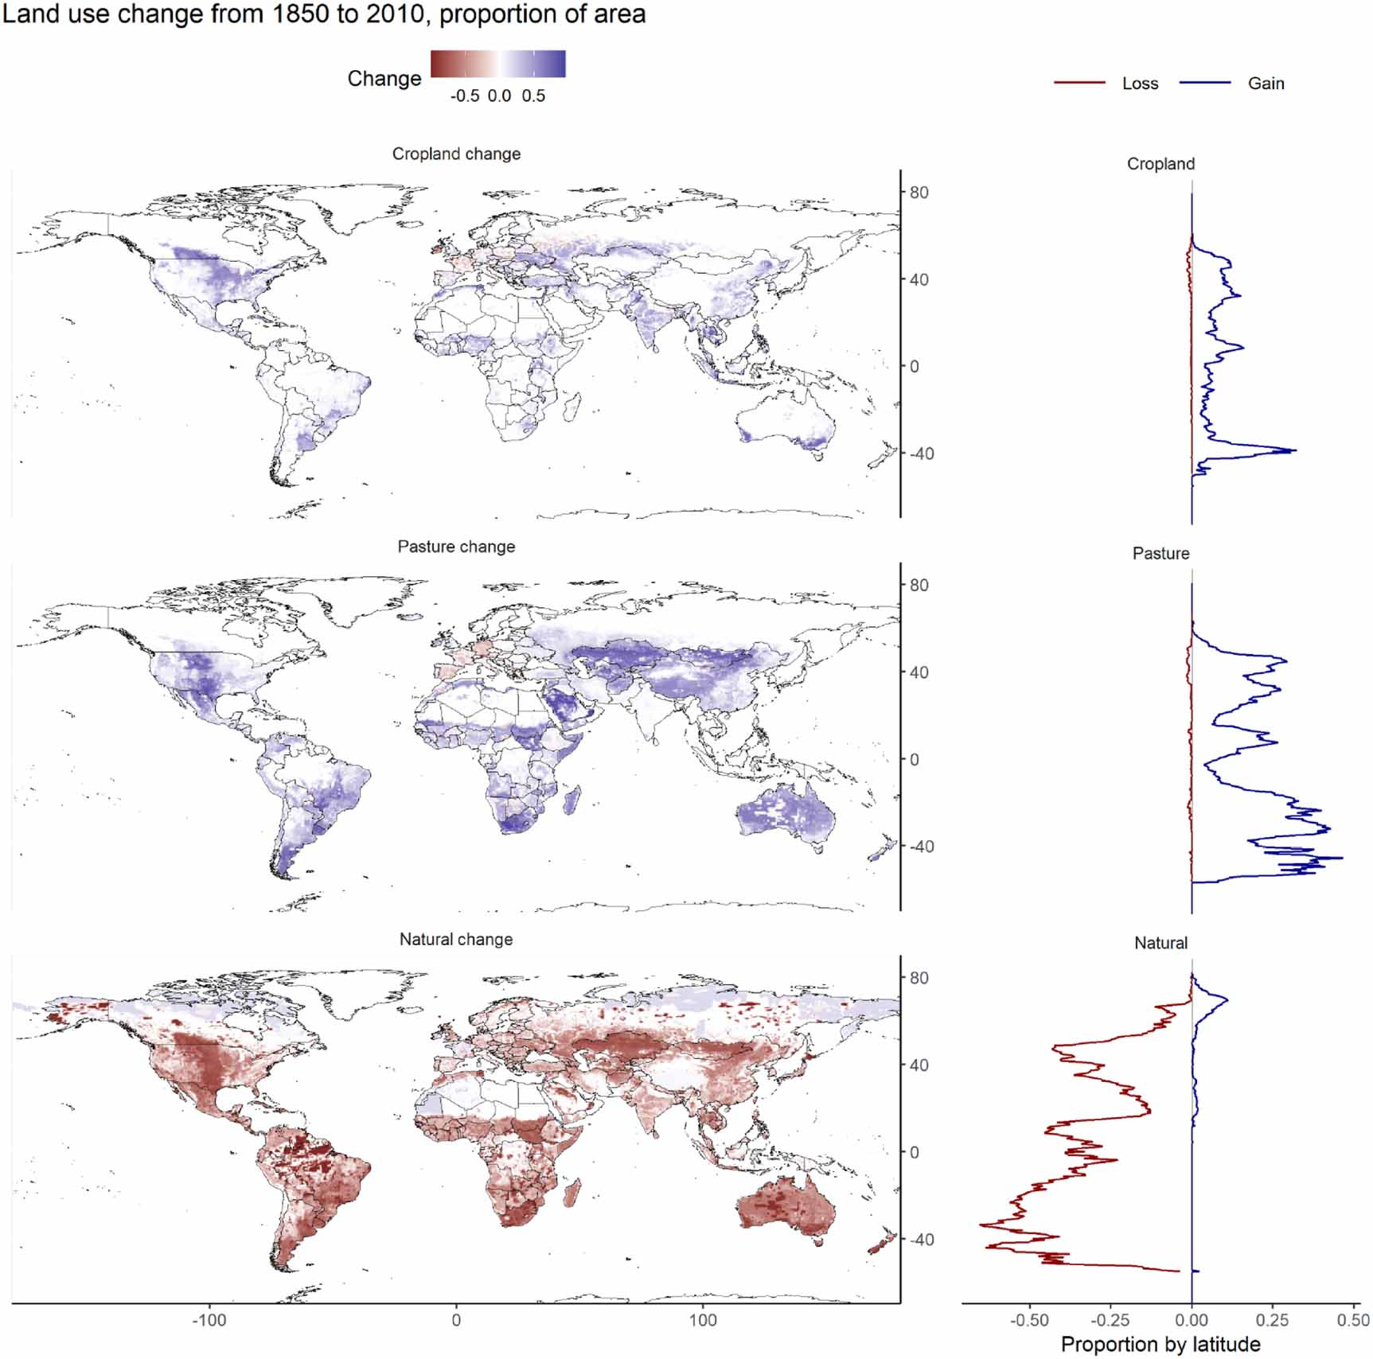
Where was the land use change? LUC in 1850 - 2010
Change as a proportion of total land area
Taylor and Rising (2021 ERL);

Slide 8
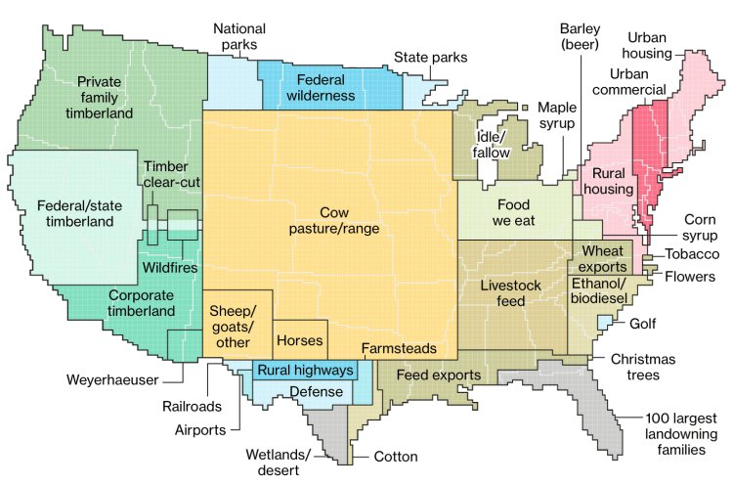
How America uses its land?
The contiguous USA: ~766 Mha
29% forest
~220 Mha
35% pasture
~260 Mha
(overestimated)
<4% urban
21% cropland
~160 Mha
~30 Mha for domestic food
Merrill and Leatherby (2018); DeLong and Hughes (2019 AJAE)

Slide 9
Land and how it is used now
Earth’s
surface
Land 29% (14.9 Bha)
Ocean 71%
Land
Habitable land (10.6 Bha)
30% Barren & Glaciers & water
Agriculture
5.1 Bha
Nature Forest
3.8 Bha
Other nature
Habitable
Urban & built-up (1%)
Crops
1.6
Grazing
3.2 Bha
Ag-Land
Planted forest (3%)
Other arable land (0.4 Bha)
Planted area (1.2 Bha)
Harvested
area
Area
1.57
Ritchie and Roser (2021); gcamdata; FAOSTAT

Slide 10
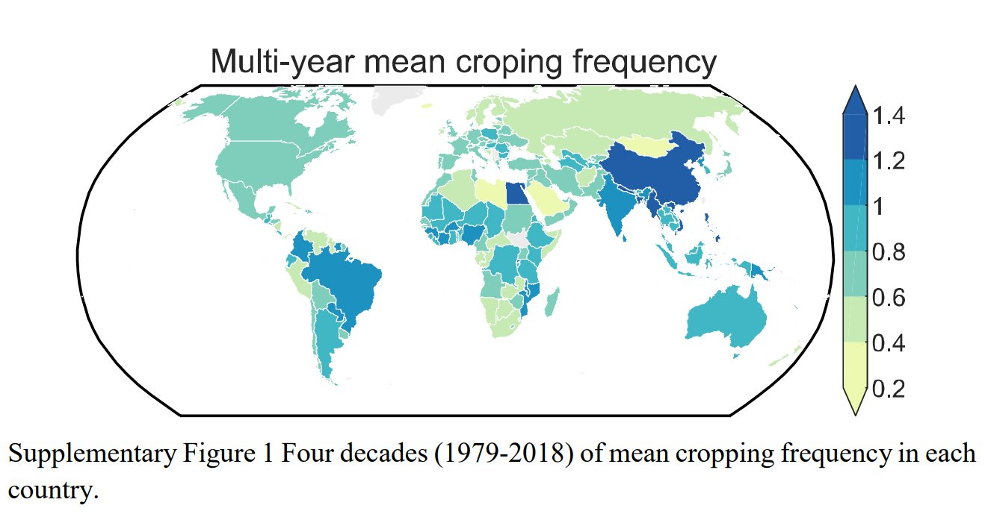
Cropping frequency: harvested area/cropland cover
FAOSTAT; Zhu et al. (2022 ncc);

Slide 11
Land and how it is used now
Earth’s
surface
Land 29% (14.9 Bha)
Ocean 71%
Land
Habitable land (10.6 Bha)
30% Barren & Glaciers & water
Agriculture
5.1 Bha
Nature Forest
3.8 Bha
Other nature
Habitable
Urban & built-up (1%)
Crops
1.6
Grazing
3.2 Bha
Ag-Land
Planted forest (3%)
Other arable land (0.4 Bha)
Planted area (1.2 Bha)
Harvested
area
Area
1.57
176+ crops (FAO)
Ritchie and Roser (2021); gcamdata; FAOSTAT

Slide 12
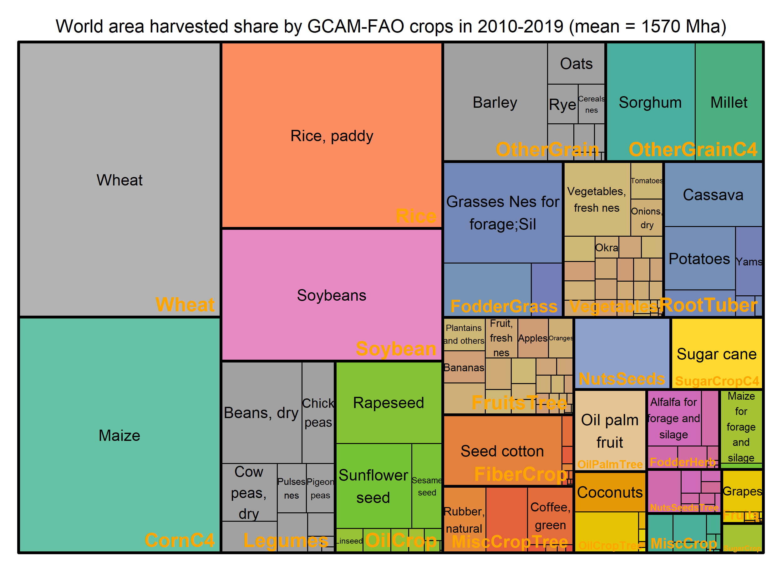
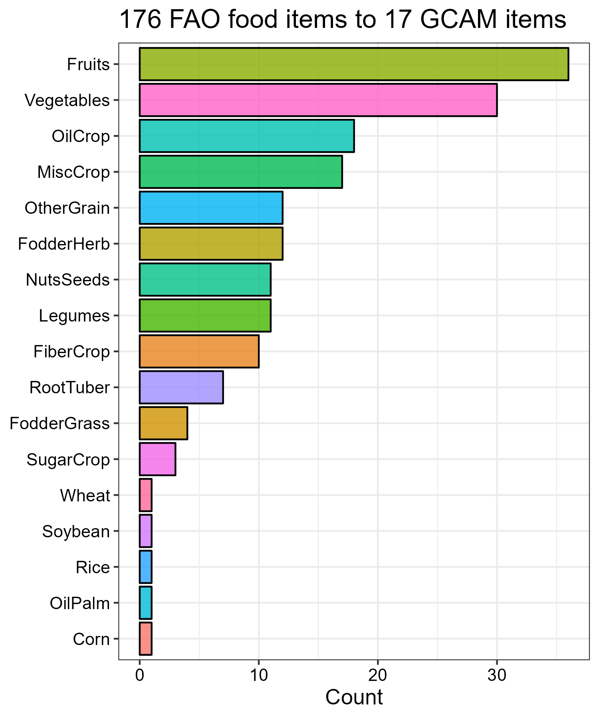
World harvested area in 2010 – 2019 Mean = 1570 Mha
gcamdata-faostat; FAOSTAT

Slide 13
Land for Agro-Food production
Earth’s
surface
Land 29% (14.9 Bha)
Ocean 71%
Land
Habitable land (10.6 Bha)
30% Barren & Glaciers & water
Agriculture
5.1 Bha
Nature Forest
3.8 Bha
Other nature
Habitable
Urban & built-up (1%)
Crops
1.6
Grazing
3.2 Bha
Ag-Land
Planted forest (3%)
Food (444+)
7770 Peta-Kcal
~2900 Kcal/ca/day
Bio-Energy
1G 3.36 EJ
Residue biomass
22 EJ
Other arable land (0.4 Bha)
Planted area (1.2 Bha)
Harvested
area
Area
1.57
Agro-Food
176+ crops (FAO)
Other use
Ritchie and Roser (2021); gcamdata; FAOSTAT

Slide 14
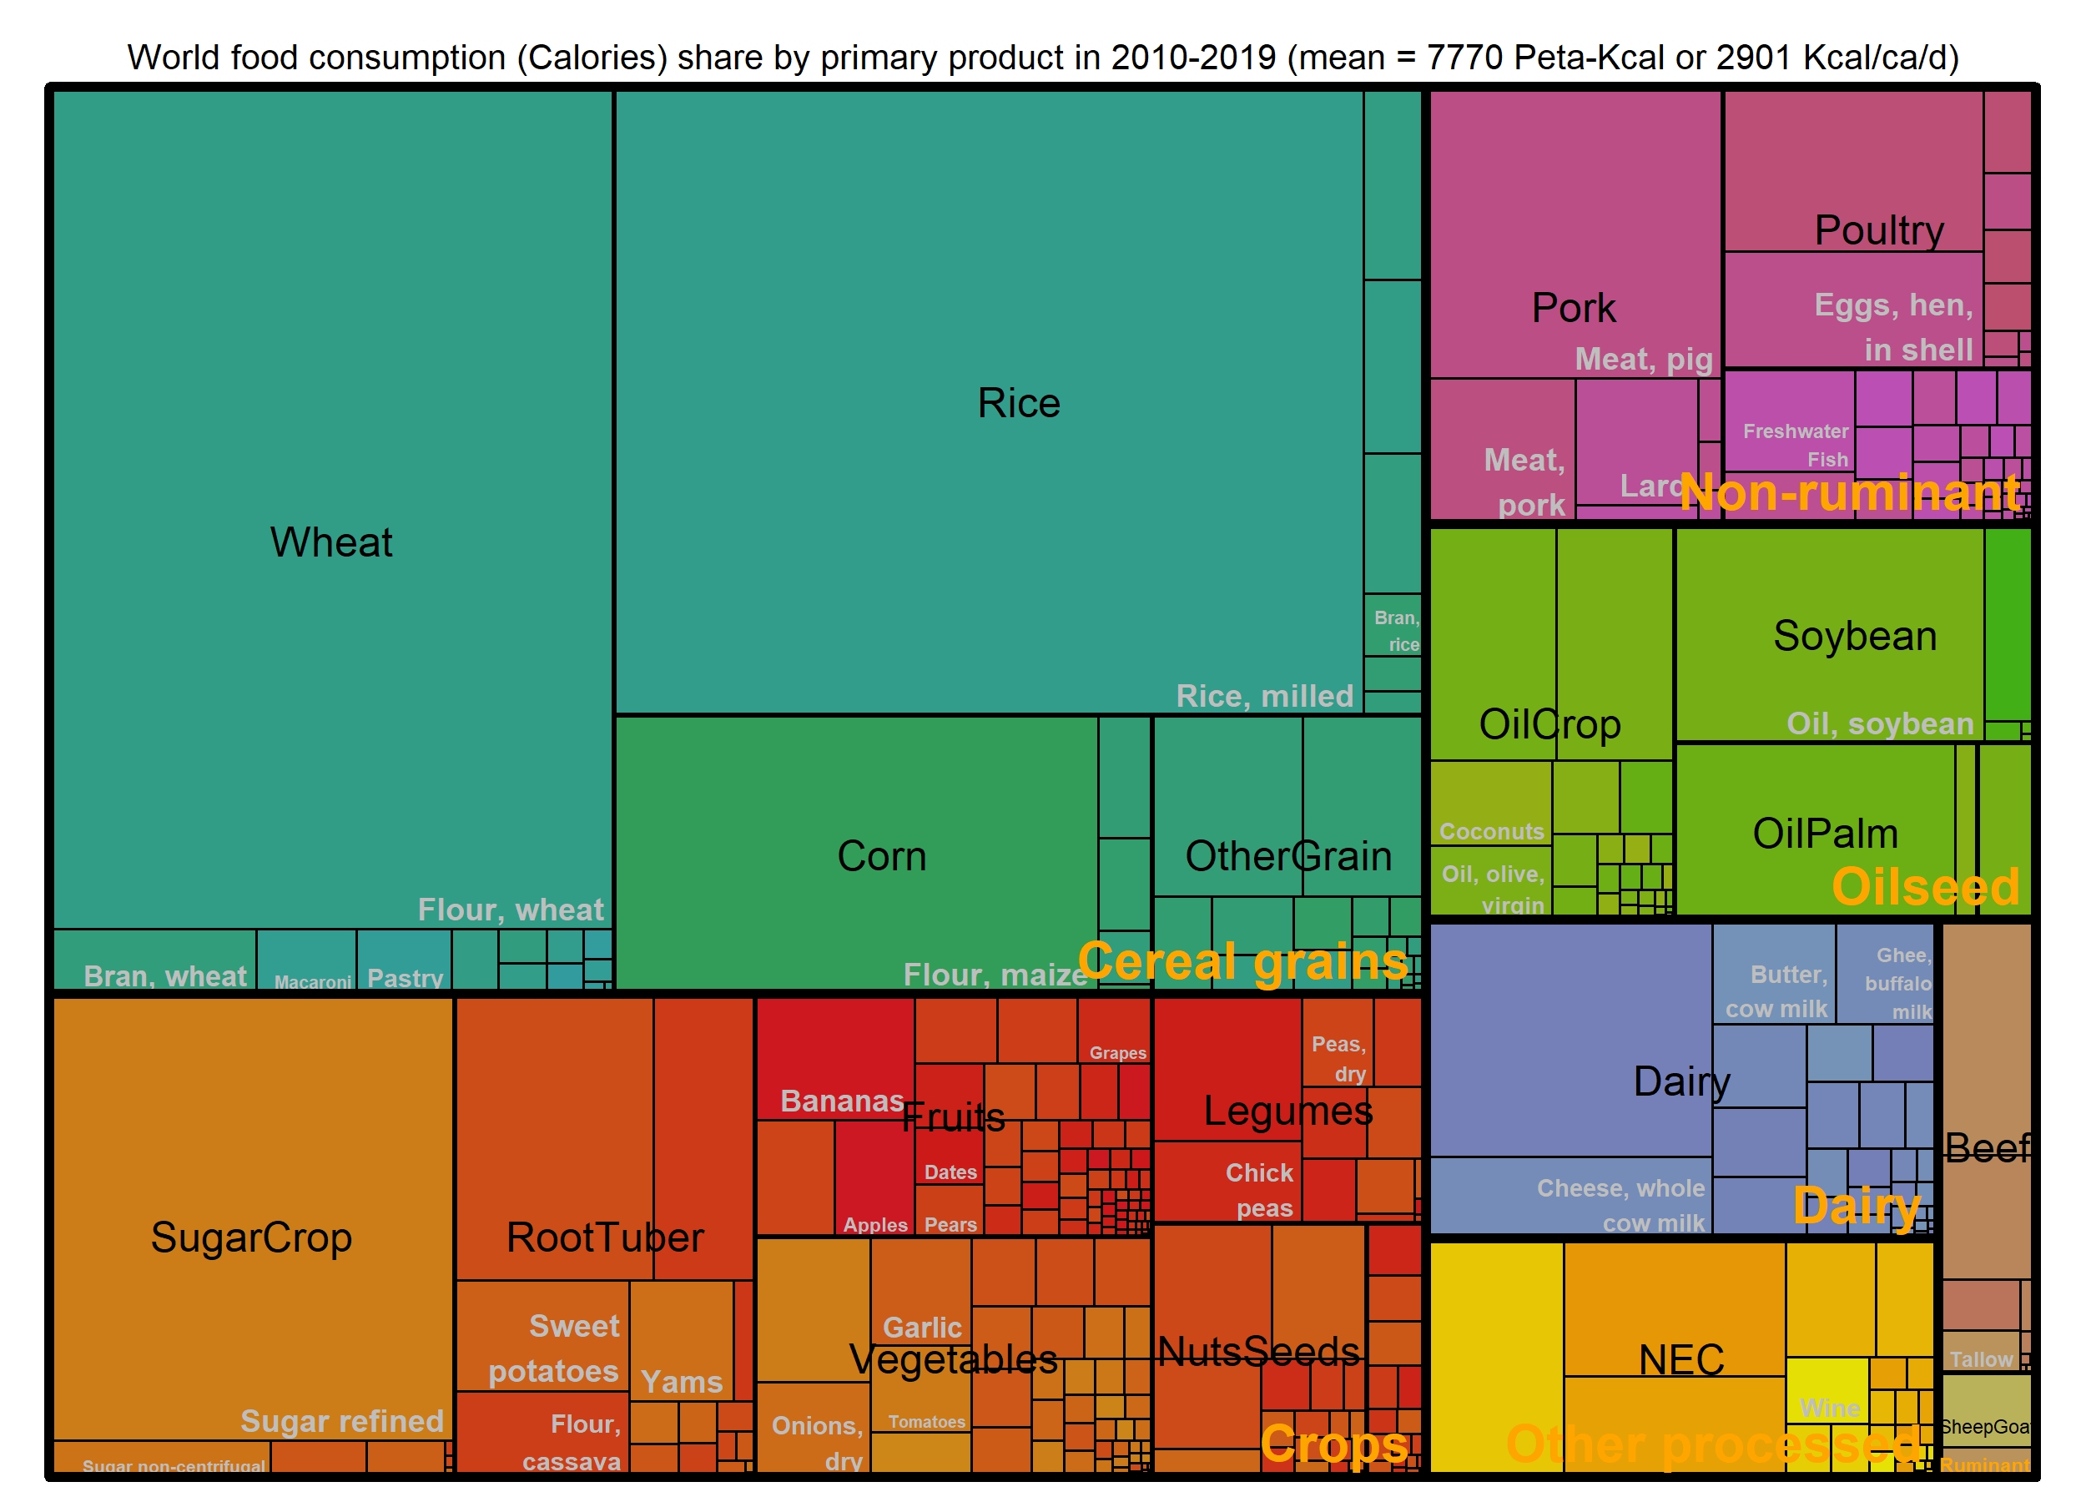
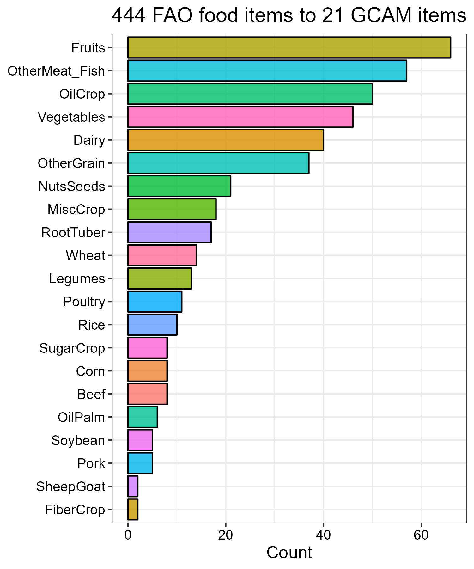
World food availability in 2010 – 2019 Mean = 7770 Peta-Kcal; 2901 Kcal/ca/d
gcamdata-faostat; FAOSTAT

Slide 15
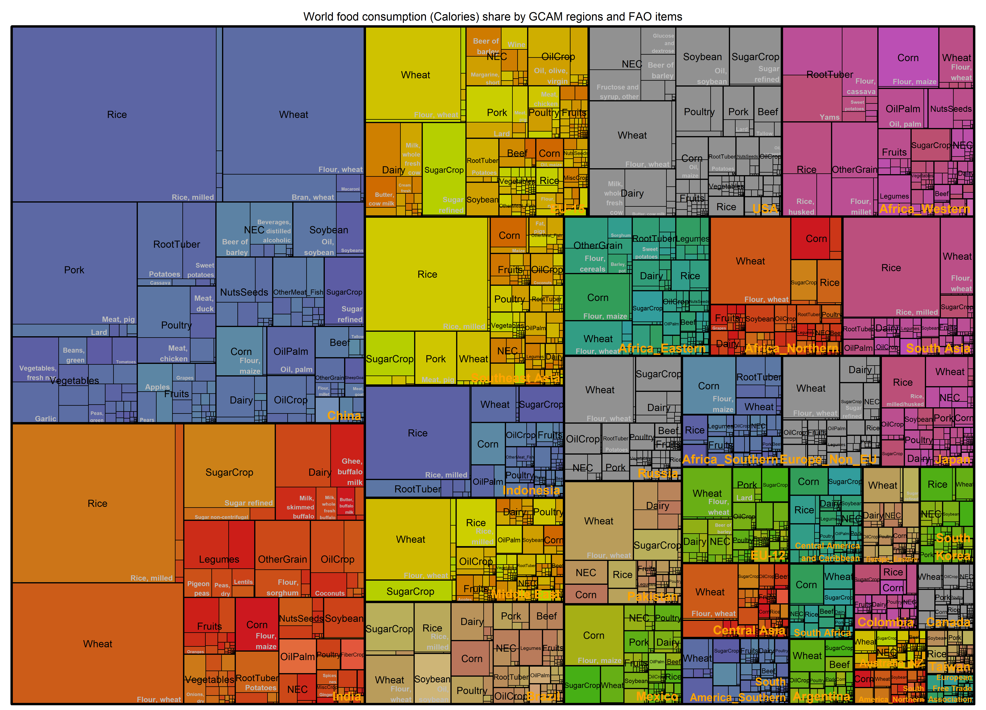
7770 Peta-Kcal by region
gcamdata-faostat; FAOSTAT

Slide 16
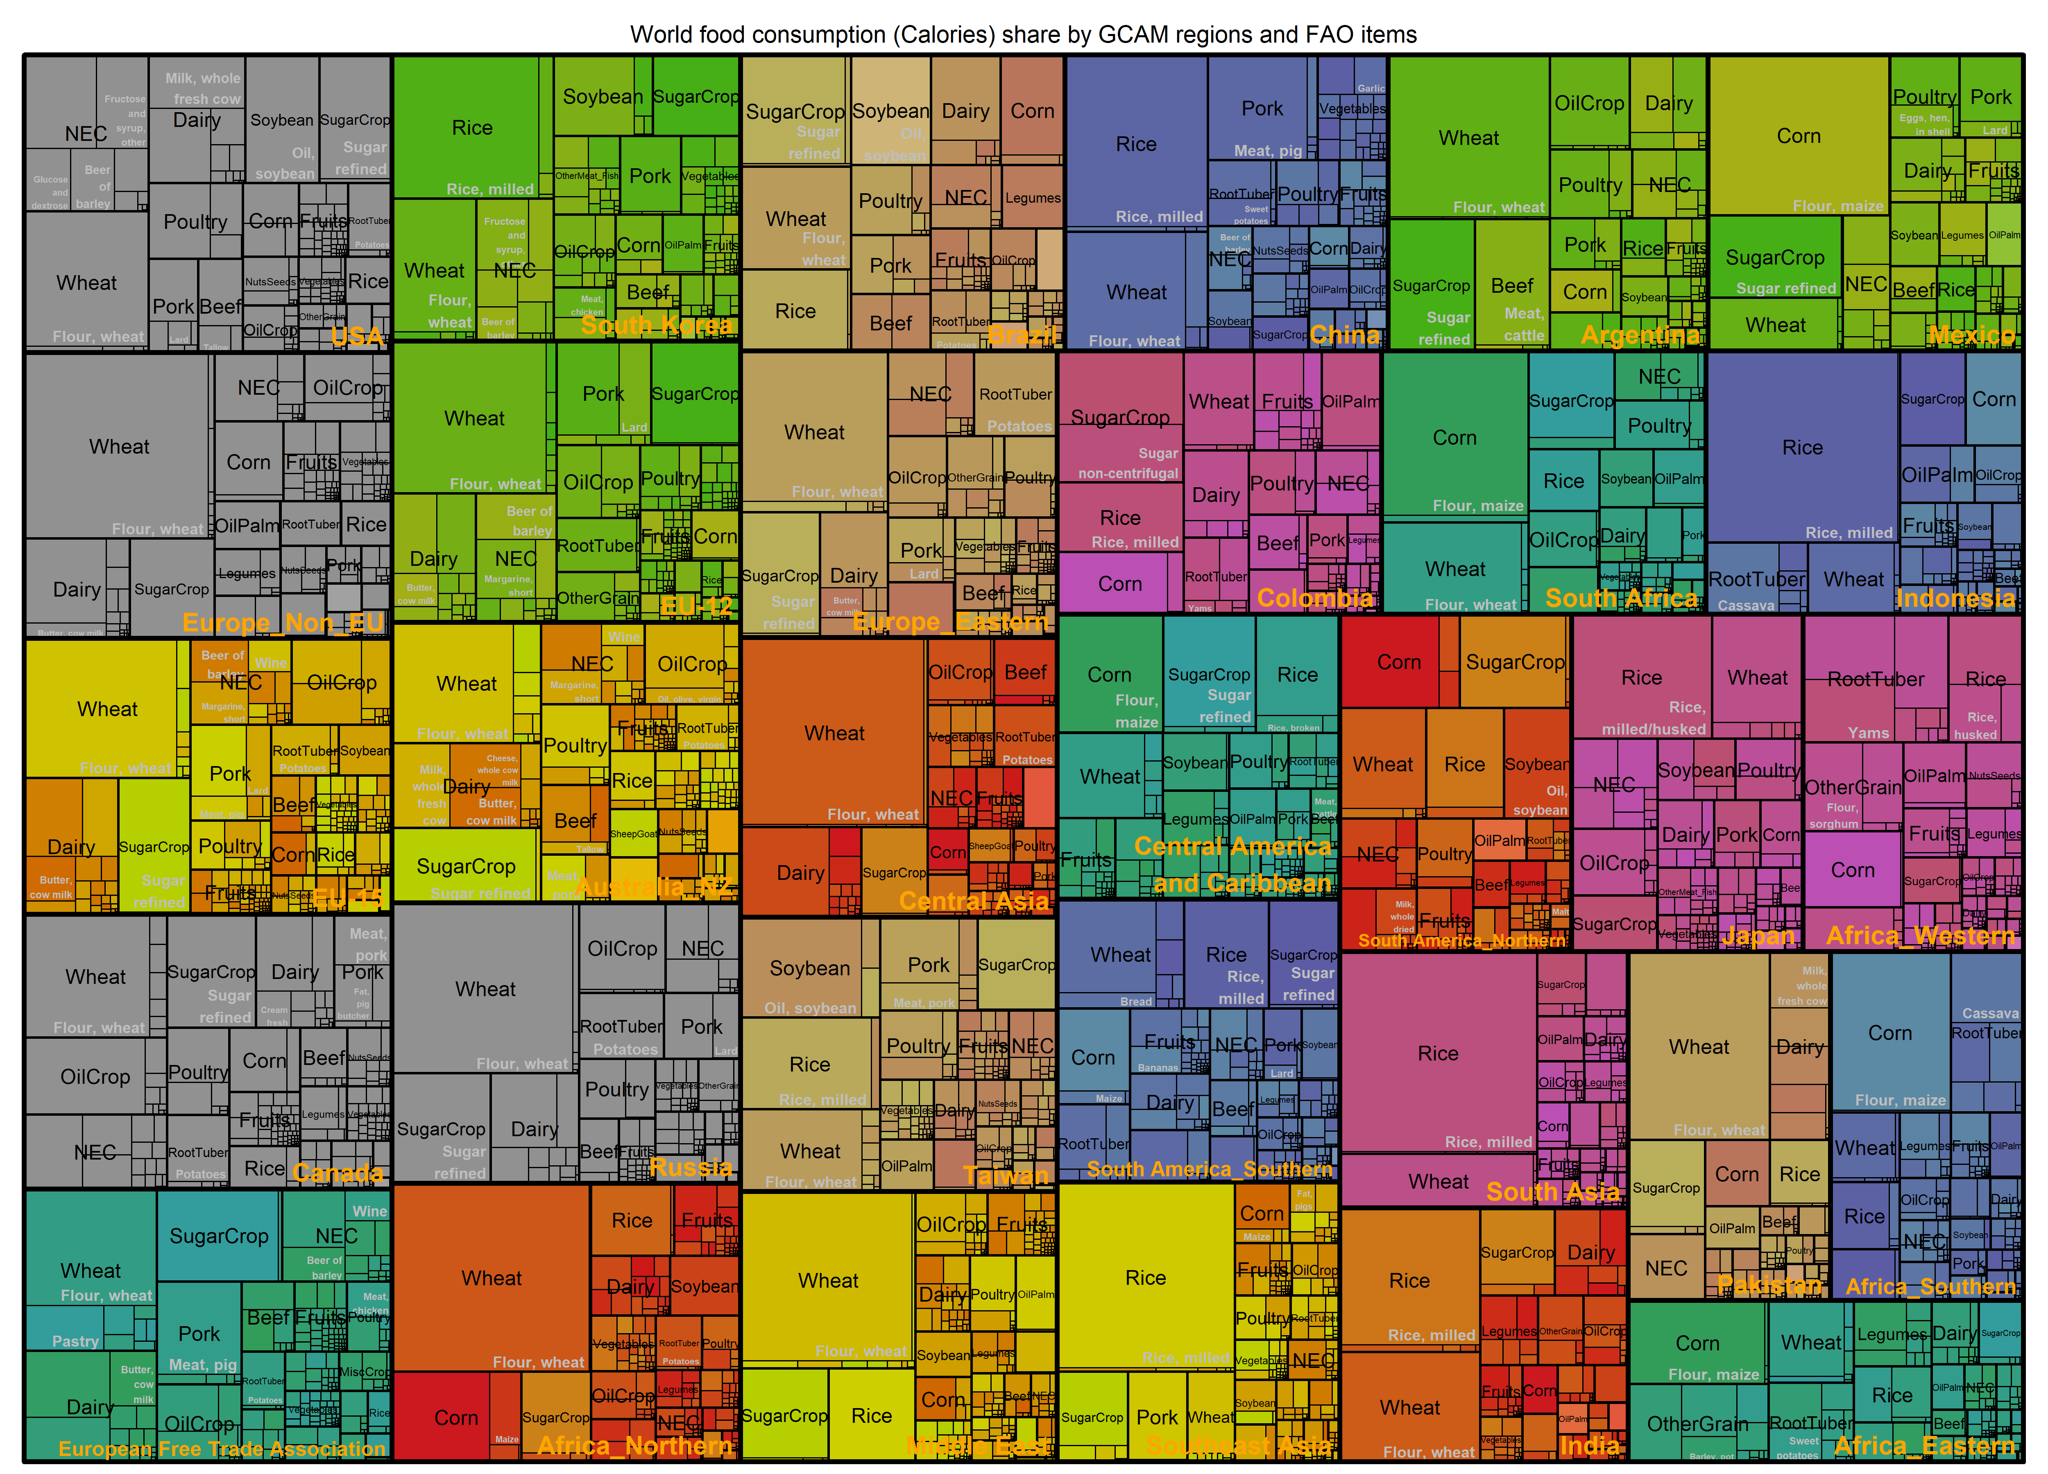
3500 kcal/ca/day
Per capita food
2500 kcal/ca/day
gcamdata-faostat; FAOSTAT

Slide 17
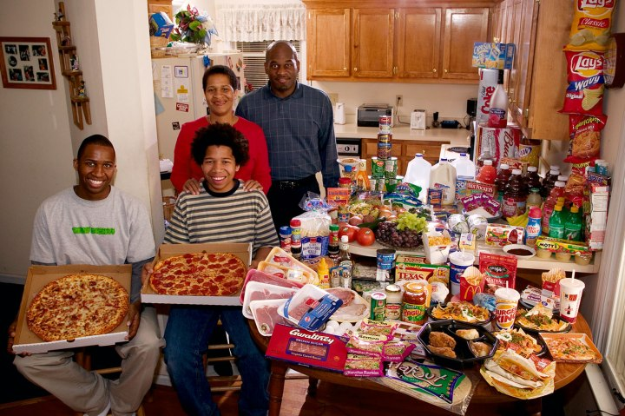
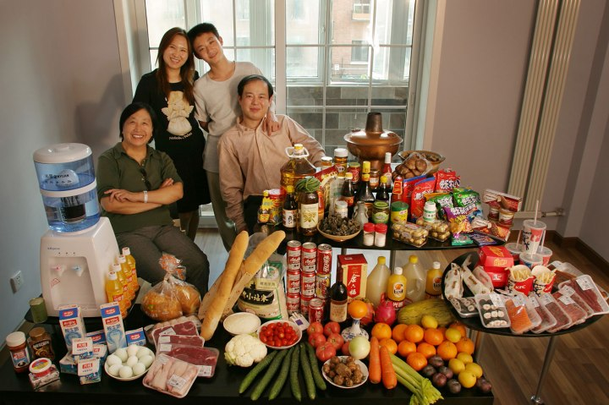
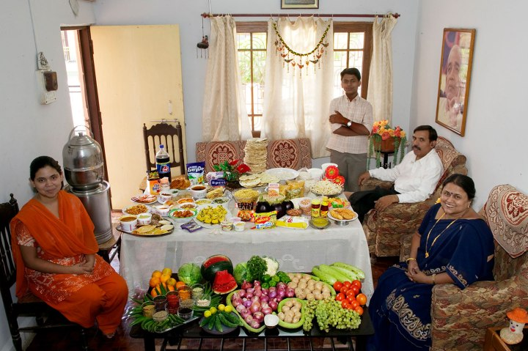
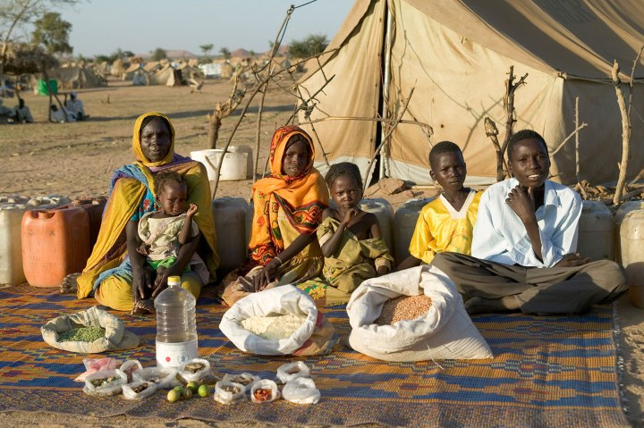
What the world eats (2011)
USA
GDP per ca. in 2011 = $50,000
Wealth rank in 2011 = #7
China
GDP per ca. in 2011 = $8394
Wealth rank in 2011 = #90
Food expenditure per week: $342
Food expenditure per week: $155
India
GDP per ca. in 2011 = $3703
Wealth rank in 2011 = #127
Chad
GDP per ca. in 2011 = $1,880
Wealth rank in 2011 = #150
Food expenditure per week: $39
Food expenditure per week: $1.23
Peter Menzel "Hungry Planet: What The World Eats" (2013);

Slide 18
Land for Agro-Food production
Earth’s
surface
Land 29% (14.9 Bha)
Ocean 71%
Land
Habitable land (10.6 Bha)
30% Barren & Glaciers & water
Agriculture
5.1 Bha
Nature Forest
3.8 Bha
Other nature
Habitable
Urban & built-up (1%)
Crops
1.6
Grazing
3.2 Bha
Ag-Land
Planted forest (3%)
Food (444+)
7770 Peta-Kcal
~2900 Kcal/ca/day
Bio-Energy
1G 3.36 EJ
Residue biomass
22 EJ
Other arable land (0.4 Bha)
Planted area (1.2 Bha)
Waste
Harvested
area
Area
1.57
Agro-Food
176+ crops (FAO)
Other use
Ritchie and Roser (2021); gcamdata; FAOSTAT

Slide 19
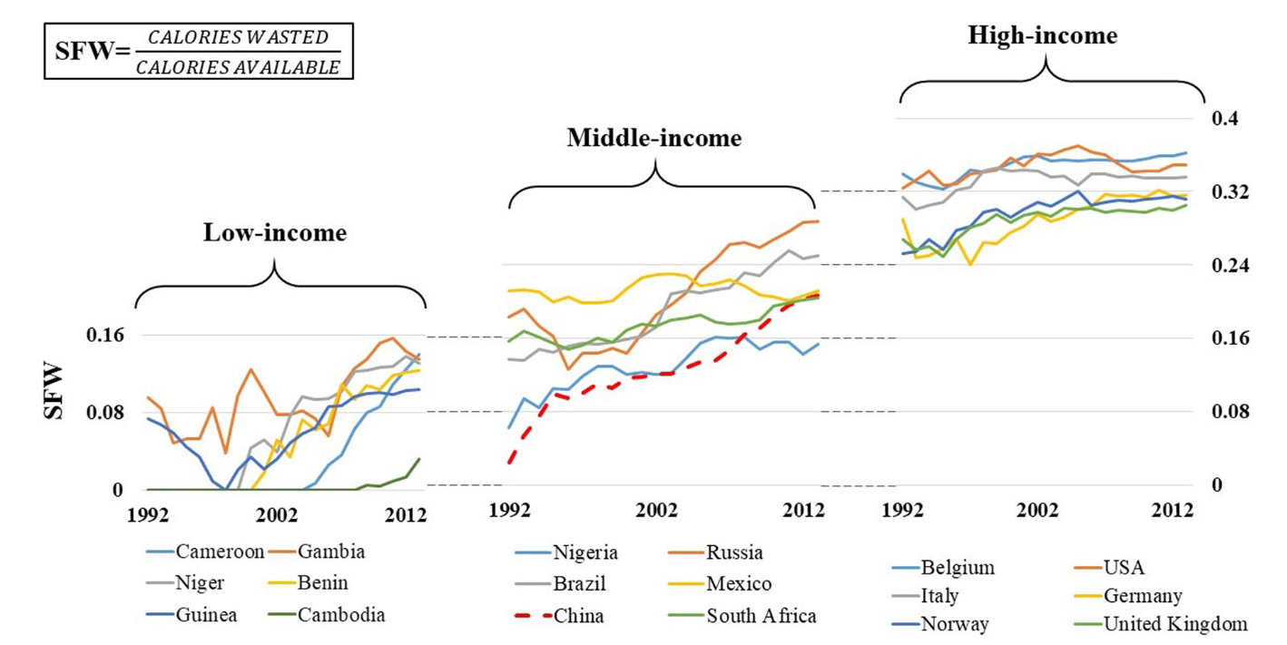
Food waste
Barrera and Hertel (2021 Food Policy)

Slide 20
Land for Agro-Food production
Earth’s
surface
Land 29% (14.9 Bha)
Ocean 71%
Land
Habitable land (10.6 Bha)
30% Barren & Glaciers & water
Agriculture
5.1 Bha
Nature Forest
3.8 Bha
Other nature
Habitable
Urban & built-up (1%)
Crops
1.6
Grazing
3.2 Bha
Ag-Land
Planted forest (3%)
Food (444+)
7770 Peta-Kcal
~2900 Kcal/ca/day
Bio-Energy
1G 3.36 EJ
Residue biomass
22 EJ
Other arable land (0.4 Bha)
Planted area (1.2 Bha)
Waste
Harvested
area
Area
1.57
Agro-Food
176+ crops (FAO)
Other use
Ritchie and Roser (2021); gcamdata; FAOSTAT

Slide 21
Agriculture vs. land by economic value
Ag
Unmanaged Land
Rental profit of Ag land:
~$0.6 Trillion
13% of primary output
<1% of GDP ~($80 Tril.)
Crops
1.6
Grazing
3.2 Bha
F
Nature Forest
3.8 Bha
Other nature
Land
$0.6 Tril
Labor
$1.4 Tril
Capital
$0.6 Tril
Inputs
Water
Food (444+)
7770 Peta-Kcal
~2900 Kcal/ca/day
Bio-Energy
1G 3.36 EJ
Residue biomass
22 EJ
Fertilizer
$0.1 Tril
Others
$0.9 Tril
Agro-Food
Processing
3-4x
Other use
Ag
$1 Tril
~$4.6 Trillion
Primary Ag output in 2014
gcamdata; FAOSTAT; GTAP Database; Aguiar et al. (2019)

Slide 22
IO table
Utilization
Food
Bio-
Energy
Other use
Net trade
Ag
Unmanaged Land
Crops
1.6
Grazing
3.2 Bha
F
Nature Forest
3.8 Bha
Other nature
Land
Labor
Capital
Inputs
Water
Fertilizer
Others
Ag
Supply
gcamdata; FAOSTAT; GTAP Database; Aguiar et al. (2019)

Slide 23
IAM AgLU Modeling
Land allocation
Utilization
Food
Bio-
Energy
Other use
Net trade
Ag
Unmanaged Land
Crops
1.6
Grazing
3.2 Bha
F
Nature Forest
3.8 Bha
Other nature
Land
Labor
Capital
Inputs
Water
Fertilizer
Staple vs.
Non-staple &
other substitution
Others
Gravity-based (Armington)
trade
Technology transformation
Ag
Energy
substitution
Supply
gcamdata; FAOSTAT; GTAP Database; Aguiar et al. (2019)

Slide 25
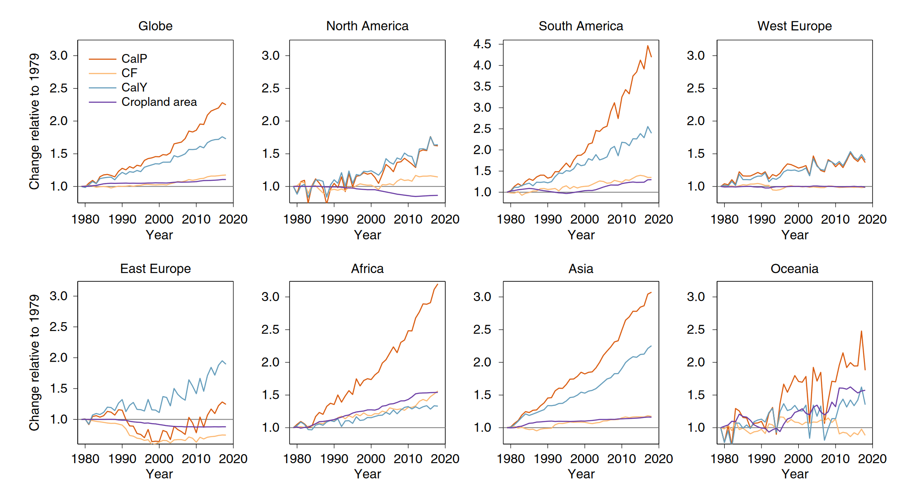
Drivers to higher agricultural output Extensification vs. intensification
+70% population
+340% GDP
+125% caloric production
+73% crop yield (production per harvested area)
+18% cropping frequency (harvested area per cropland)
+11% cropland cover
Ag production and land are decoupling
FAOSTAT; Zhu et al. (2022 ncc);

Slide 26
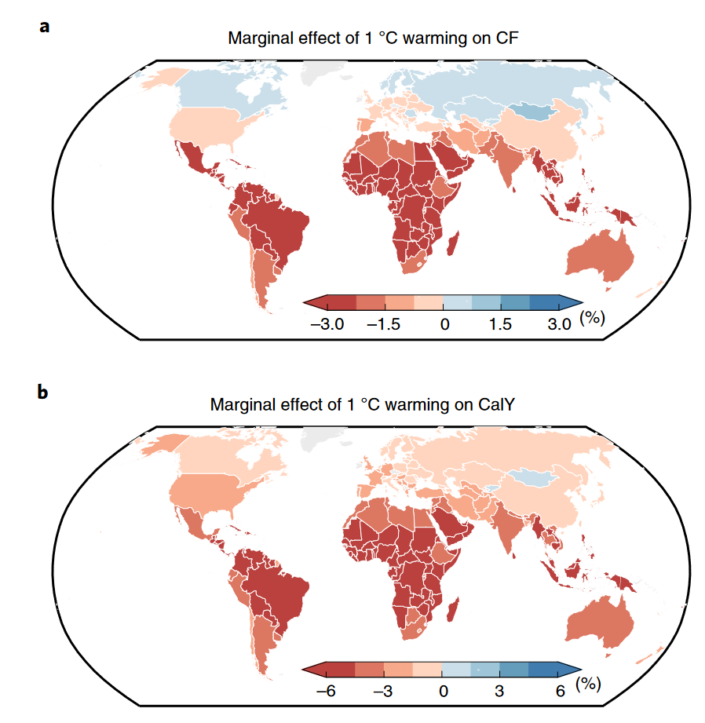
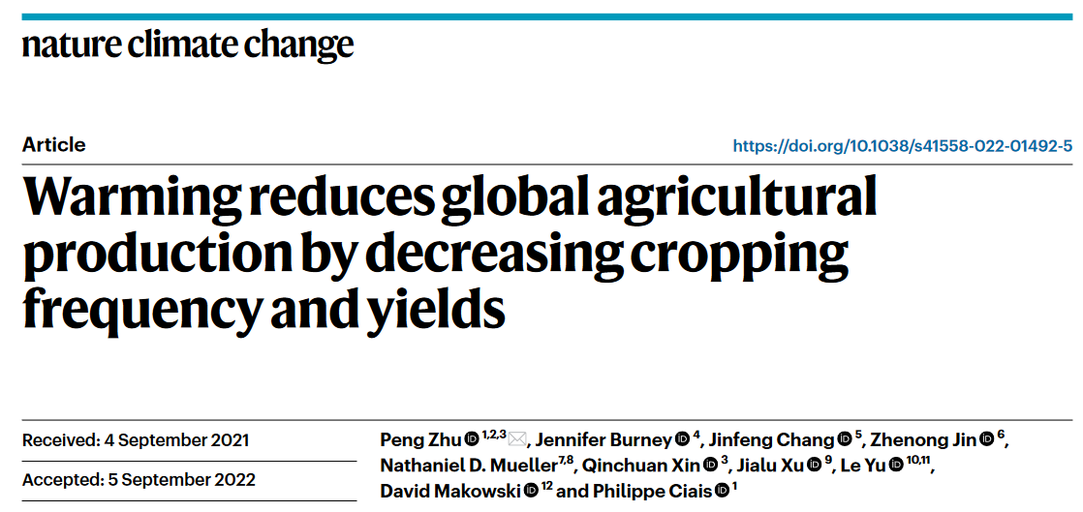
Climate impacts on cropping frequency (CF)
caloric yield
+1 °C warming leads to
-3.6% in caloric yield
-1.8% in harvest frequency
The behavior may not be well identified
Zhu et al. (2022 ncc);

Slide 27
Regional heterogeneity
FAOSTAT; Zhu et al. (2022 ncc);

Slide 28
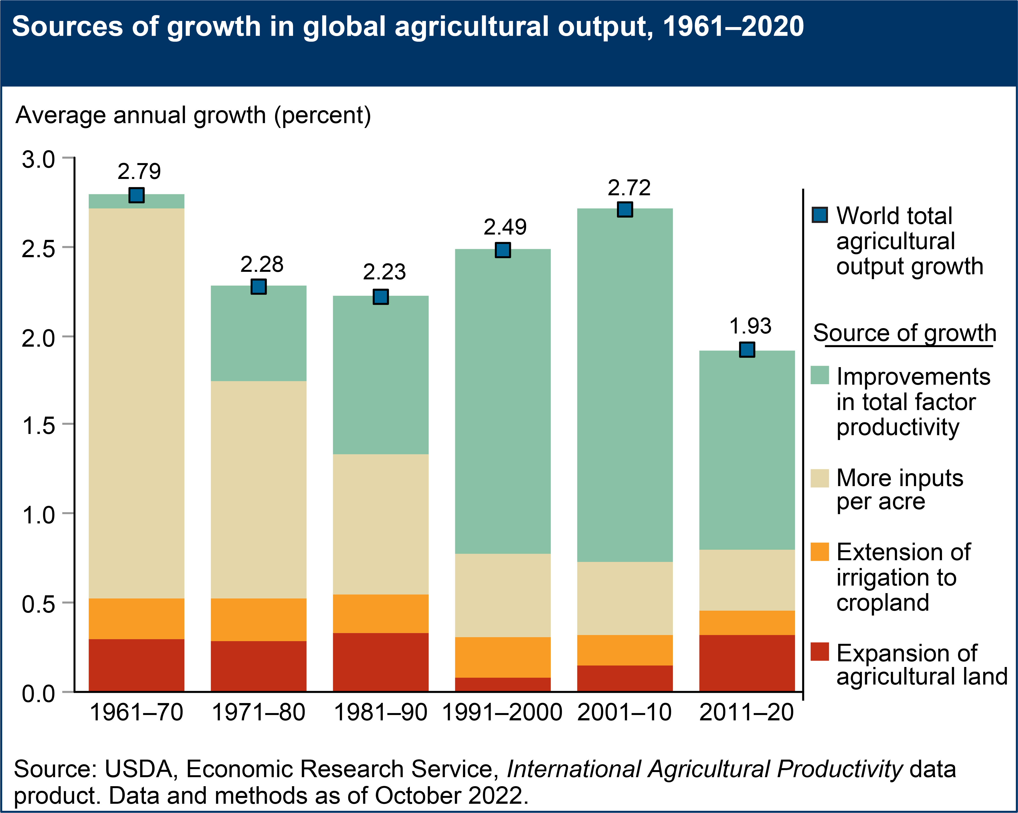
Driver of the yield growth
Total factor productivity (TFP)
Partial FPs
Technology
Climate impacts
USDA (2022)

Slide 29
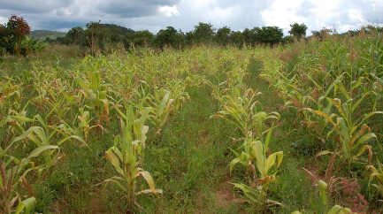
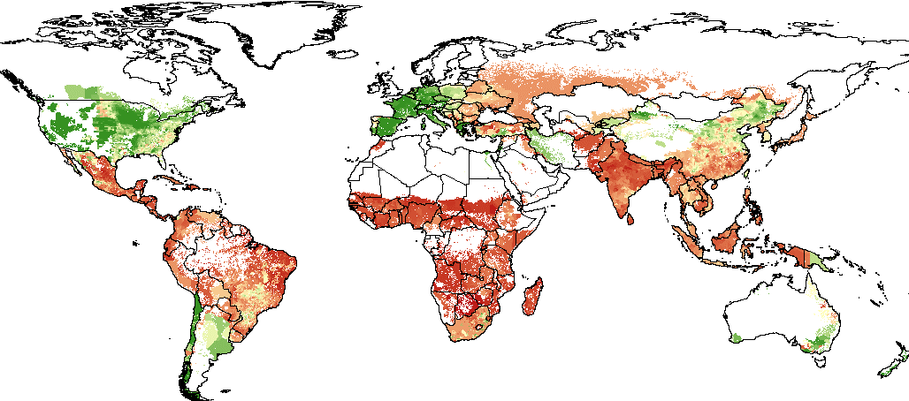
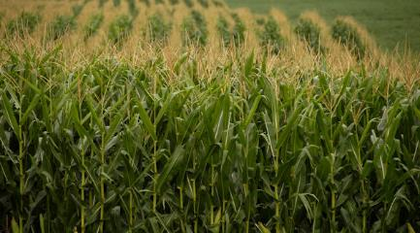
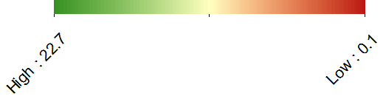
Yield gap
Corn yields across the world
Corn plots in Africa vs. US Midwest
Monfreda et al (2008) & Baldos (2015)

Slide 30
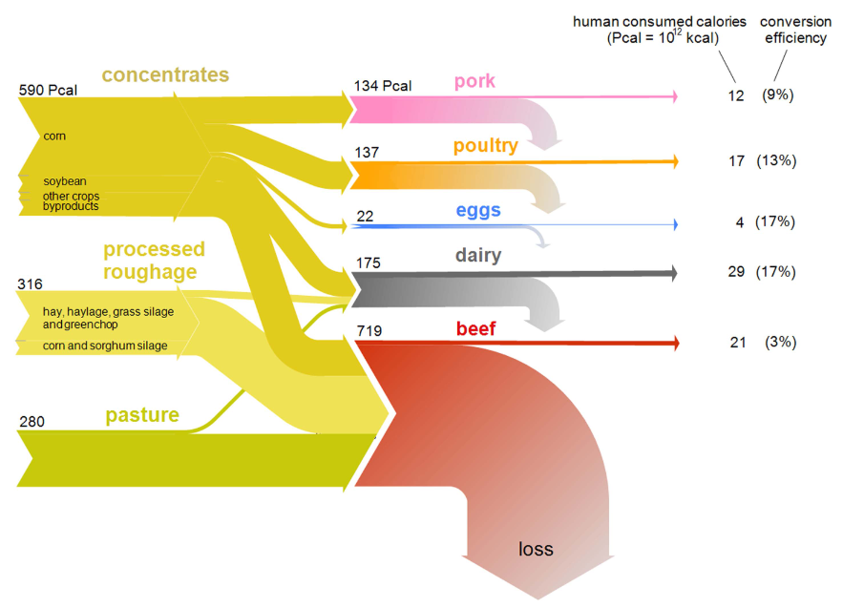
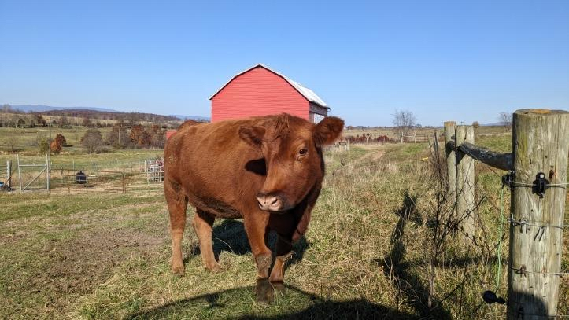
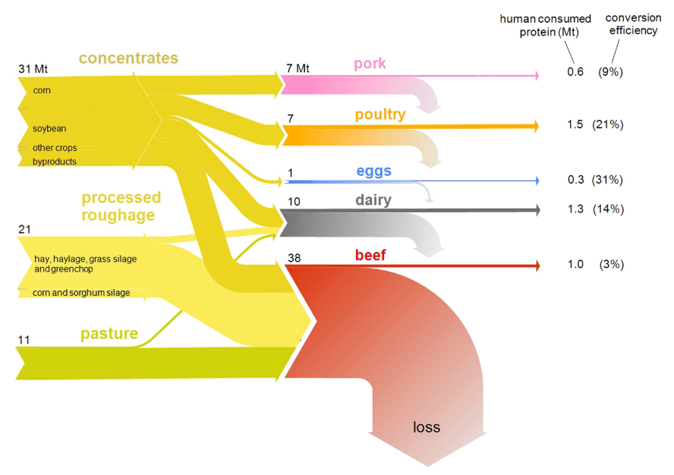
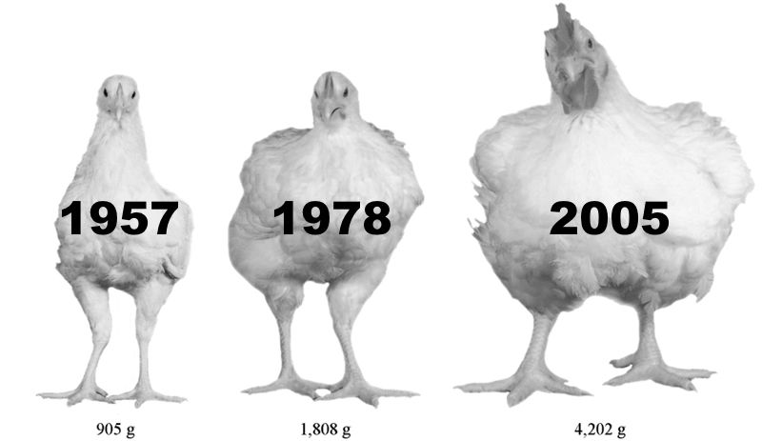
Livestock feed conversion efficiency (US)
Calorie conversion
Protein conversion
Photo credit: Kelly Casper
Shepon et al. (2016 ERL); Zuidhof et al. (2014 Poultry Sci)

Slide 31
Connect land hectares to food calories
Supply-Utilization-Balance
Land Allocation
Ag Input
Regional supply
Regional utilization
Food
Cropland (Mha)
Area: Wheat, Corn, Rice, Fodder, etc. (Mha)
Crop
Yield
Production
(Mt)
Other Use (Mt)
Pasture (Mha)
Managed or not
Food (Mt)
Food (Pcal)
Calorie
Conversion
Rate
Fertilizer (Mt N)
Feed
Conversion
Rate
Feed (Mt)
Forest (Mha)
Managed or not
Import
(Mt)
Water (Km3)
Food
(Kcal/ca/day)
Grass and Shrub (Mha)
Bioenergy (Mt)
Others (Mha
Other inputs
Export (Mt)
Prices and value flows; producer prices ($/kg)
Emissions: LULUCF and agricultural GHG (CO2eq)

Slide 32
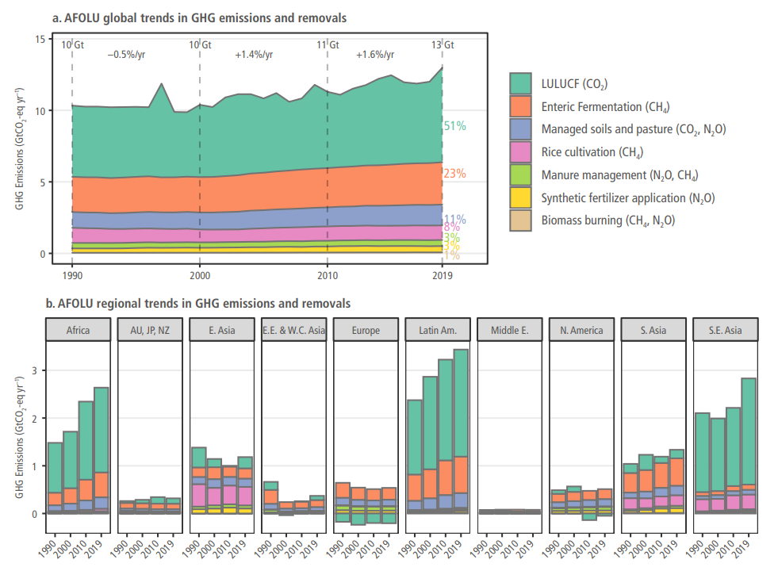
Agriculture, forestry and other land use (AFOLU)
Land use, land use change, and forestry (LULUCF)
Mainly driven by deforestation
IPCC AR6 WG3 chp7 Fig. 7.3 (2022)
Notes:
urea application

Slide 33
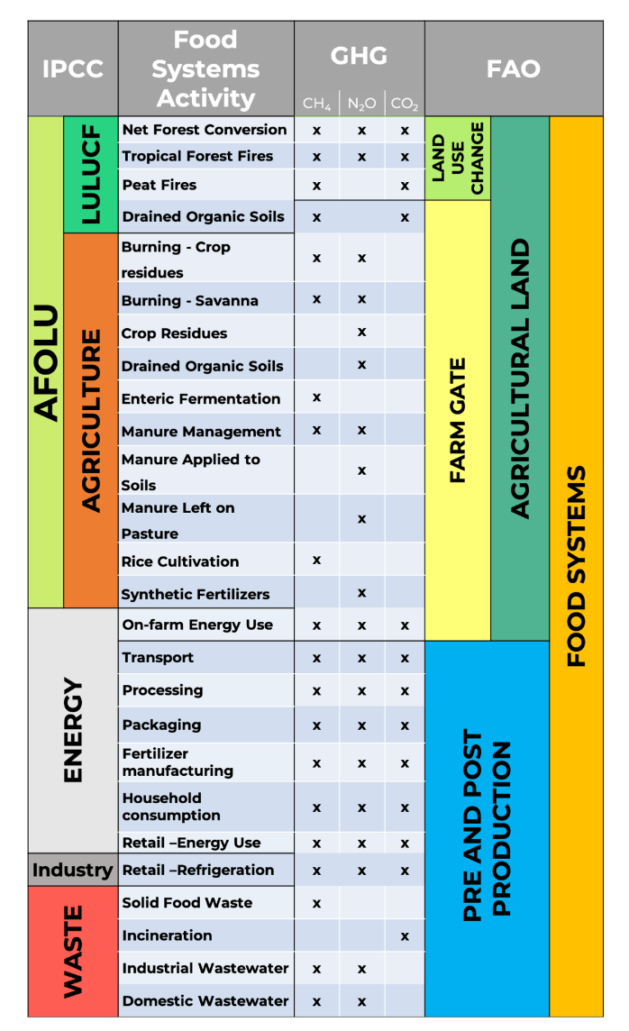
Mapping of emissions across agri-food systems
GHG Emissions:
LULUCF < AFOLU < food system
Tubiello et al. (2022 ESSD)

Slide 34
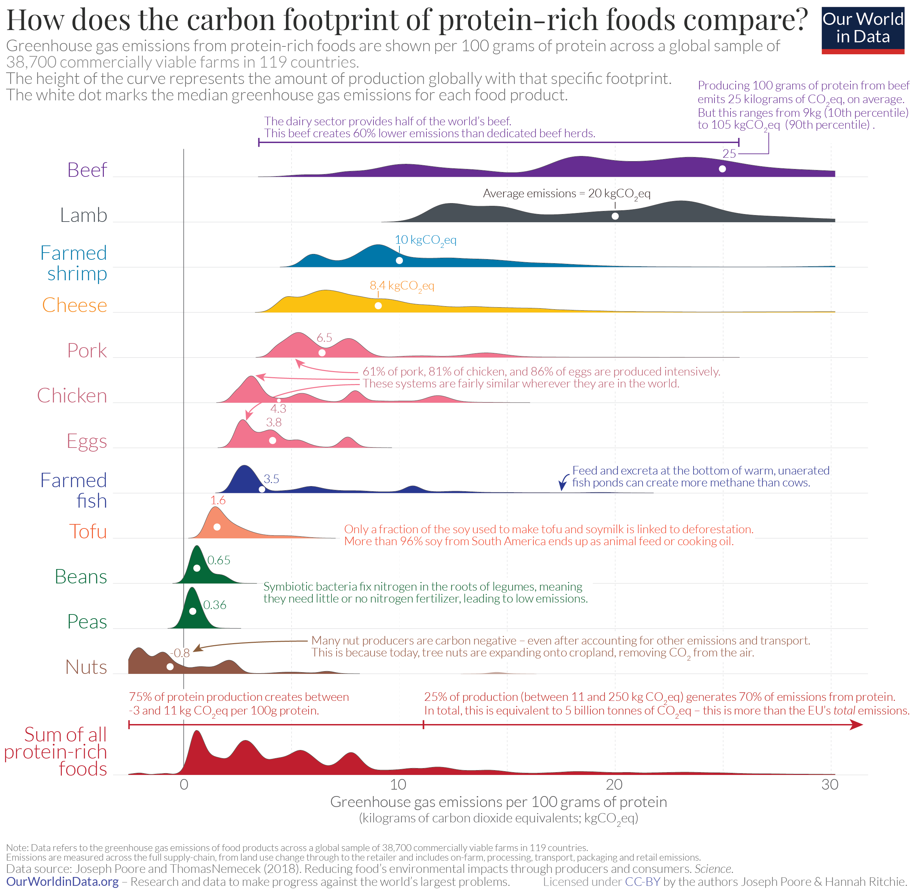
OurWorldinData; Ritchie (2020)

Slide 35
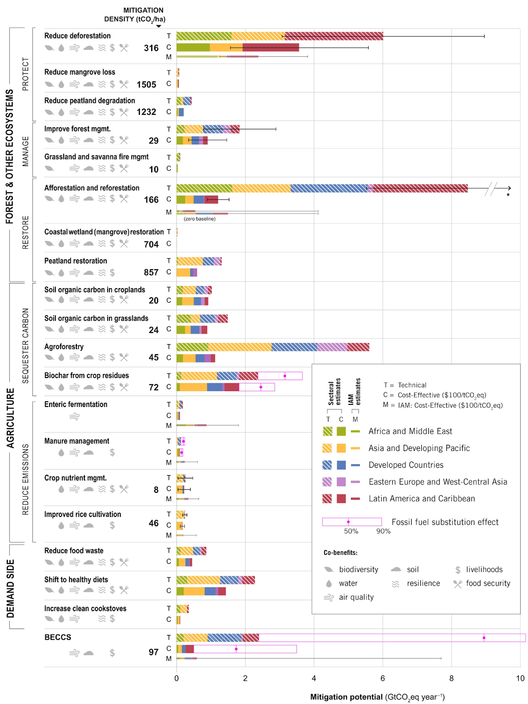
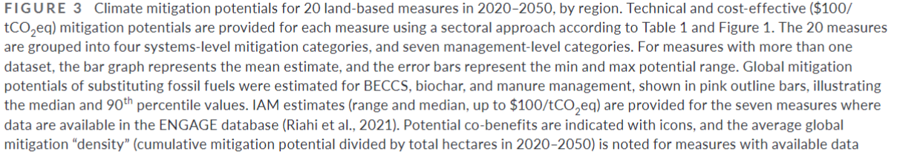
Land-based mitigation
20 measures (Roe et al., 2021 GCB) by 2050
Sectoral: Technical, Cost-effective <100$/tCO2eq
IAM: Median in model intercomparison
Forest: T 18, C 6.6, M 3.5 GtCO2eq/yr
Ag: T 11, C 5.3, M 2.7 GtCO2eq/yr
BECCS: T 2.5, C 0.5, M 0.7 GtCO2eq/yr
IAMs expects large BECCS after 2050
by 2050

Slide 36
Assessing climate impacts on agriculture and land use
Relationship between climate variability and economic responses
Modeling
chain
Climate model
Crop model
Economic Model (GCAM)
Temperature
Precipitation
C concentration
Wind speed
Etc.
Biophysical yield
Harvested area
Production
Consumption
Prices
Etc.
Variable
Biophysical yield is an agronomic representation of all climate variables
Relationship between climate interannual variability and economic responses
Annual step modeling & separating planting and harvesting decisions
Zhao et al. (2021 ERL)

Slide 37
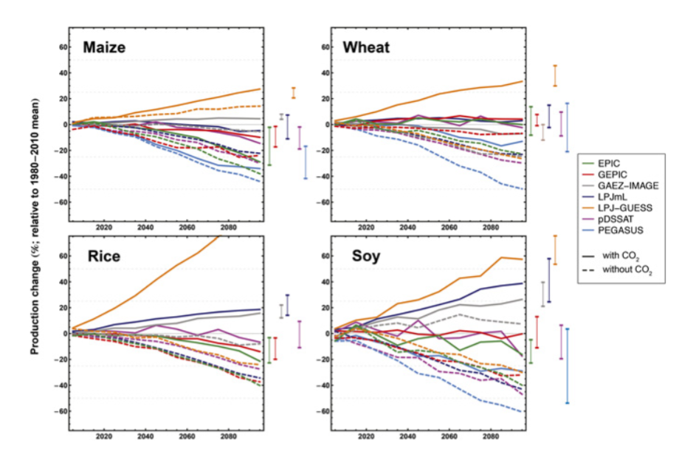
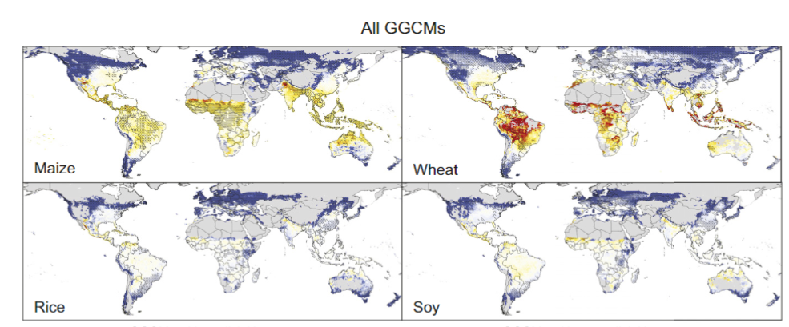
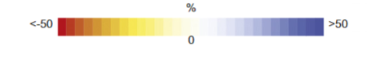
RCP8.5 model mean crop biophysical yield impact (ISIMIP model intercomparison)
End of the century impacts
Median values
Rainfed with carbon fertilization
Rosenzweig et al. (2014 PNAS)

Slide 38
Climate impacts on global agriculture to mid-century
Zhao et al. (2021 ERL);

Slide 39
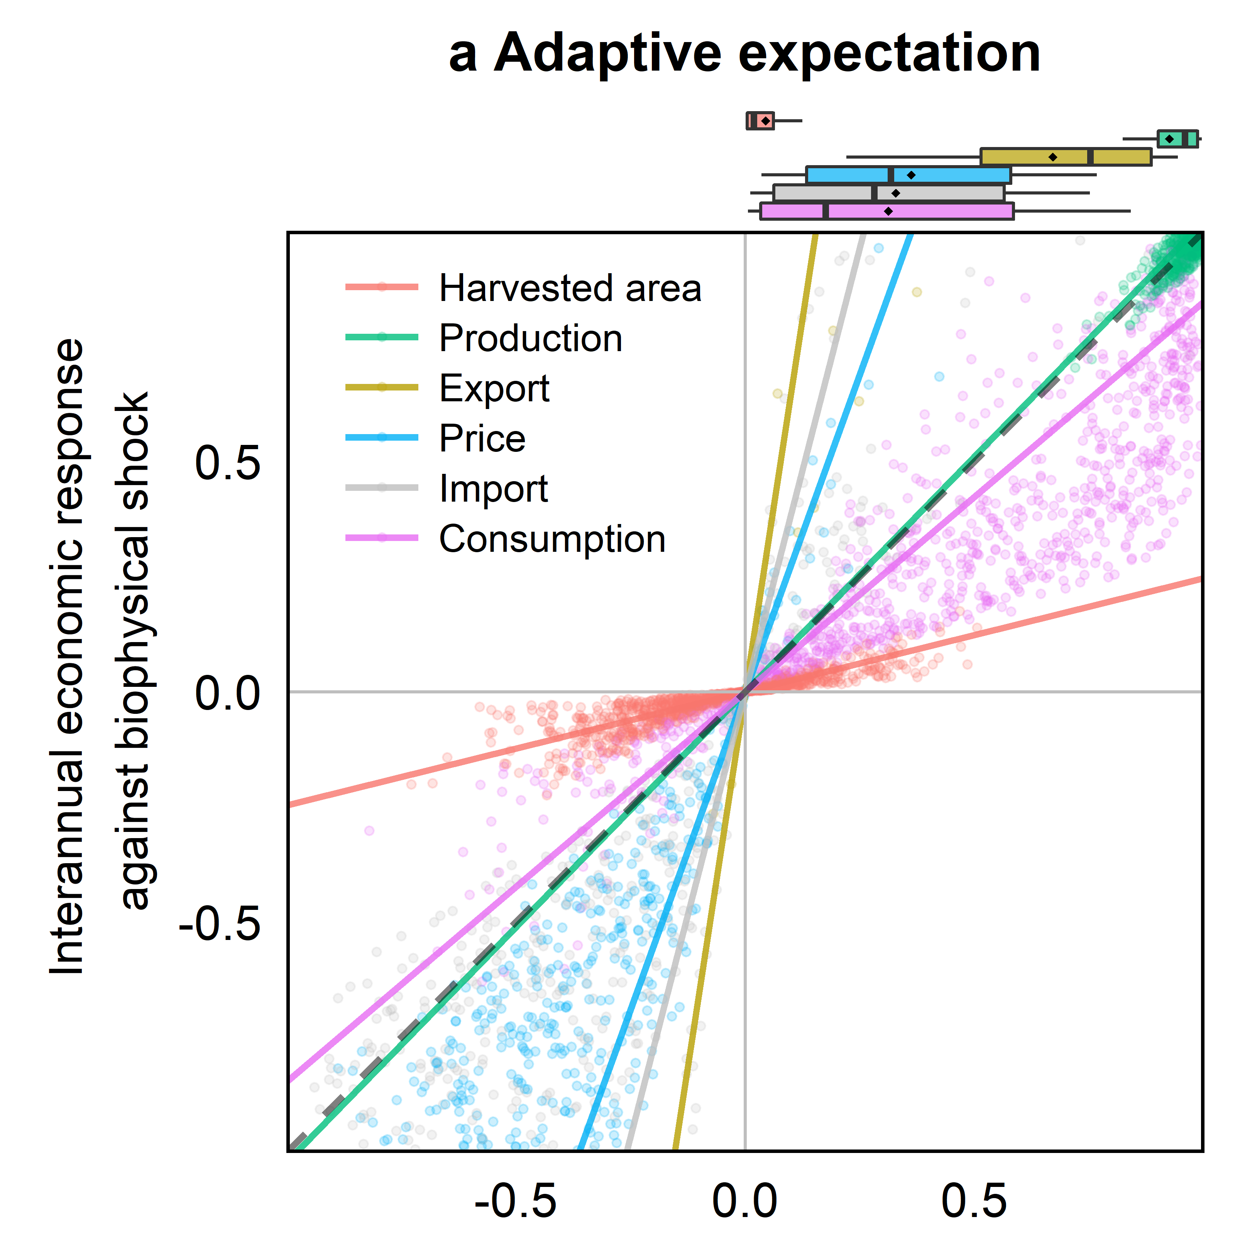
Interannual economic responses and correlations to biophysical yield shocks
Bigger slope indicates stronger transmission of biophysical yield (climate) variability to the economic response
Trade reduces and mediate market variability due to climate impacts
2.8
25%
Beta coefficient
Correlation coefficient b/t biophysical shock & economic responses
Zhao et al. (2021 ERL);

Slide 40
Market integration and trade liberalization
Global agricultural markets became increasingly integrated
Industrialization and globalization
Trade cost and barrier reductions
Fix the “Missing globalization” issue (Donaldson, 2015)
Crop consumption: total (+60%) vs. imported (+150%) in 1995 - 2015
Underestimate trade expansions and gains from market integration
Trade integration scenarios to lower non-economic barriers
Global Ag market become 50% more integrated in every 40 years
Lower “distance” & higher “gravity”
Improves adaptation with the evolution of comparative advantage
Zhao et al. 2021 EAP & Zhao et al. 2022 GEC

Slide 41
Other AgLU related studies
Agricultural labor supply & climate impacts
Hill et al. (2021 ARRE) & Lima et al. (2021 ERL)
Biodiversity: Leclère et al. (2020 nature)
Climate impacts on TFP: Jägermeyr et al. (2021 nfood) & Ortiz-Bobea et al. (2021 ncc)
Eutrophication: Sinha et al. (2017 science)
Food demand: Edmonds et al. (2017 CCE)
Hindcast experiment /historical validation
Calvin et al. (2017 CCE) & Calvin et al. (2022 GMD) & Zhao et al. (2021 EAP)
Land-based mitigation
Calvin et al. (2014 CC) & Wise et al. (2009 science) & Fujimori et al. (2022 nfood)
Nutrient and Health: Willett et al. (2019 Lancet)
Virtual water & land-use emissions
Graham et al. (2020 nc) & Hong et al. (2022 science)

Slide 43
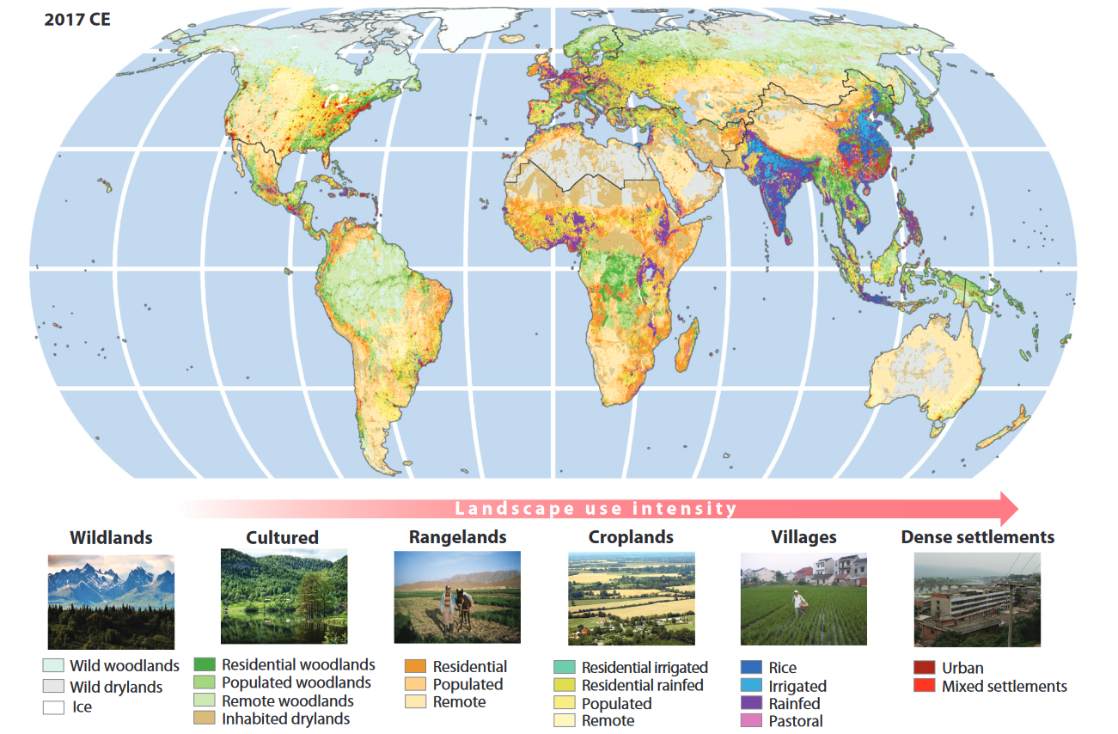
Land use over space
Ellis (2021); Goldewijk et al. (2017)

Slide 45
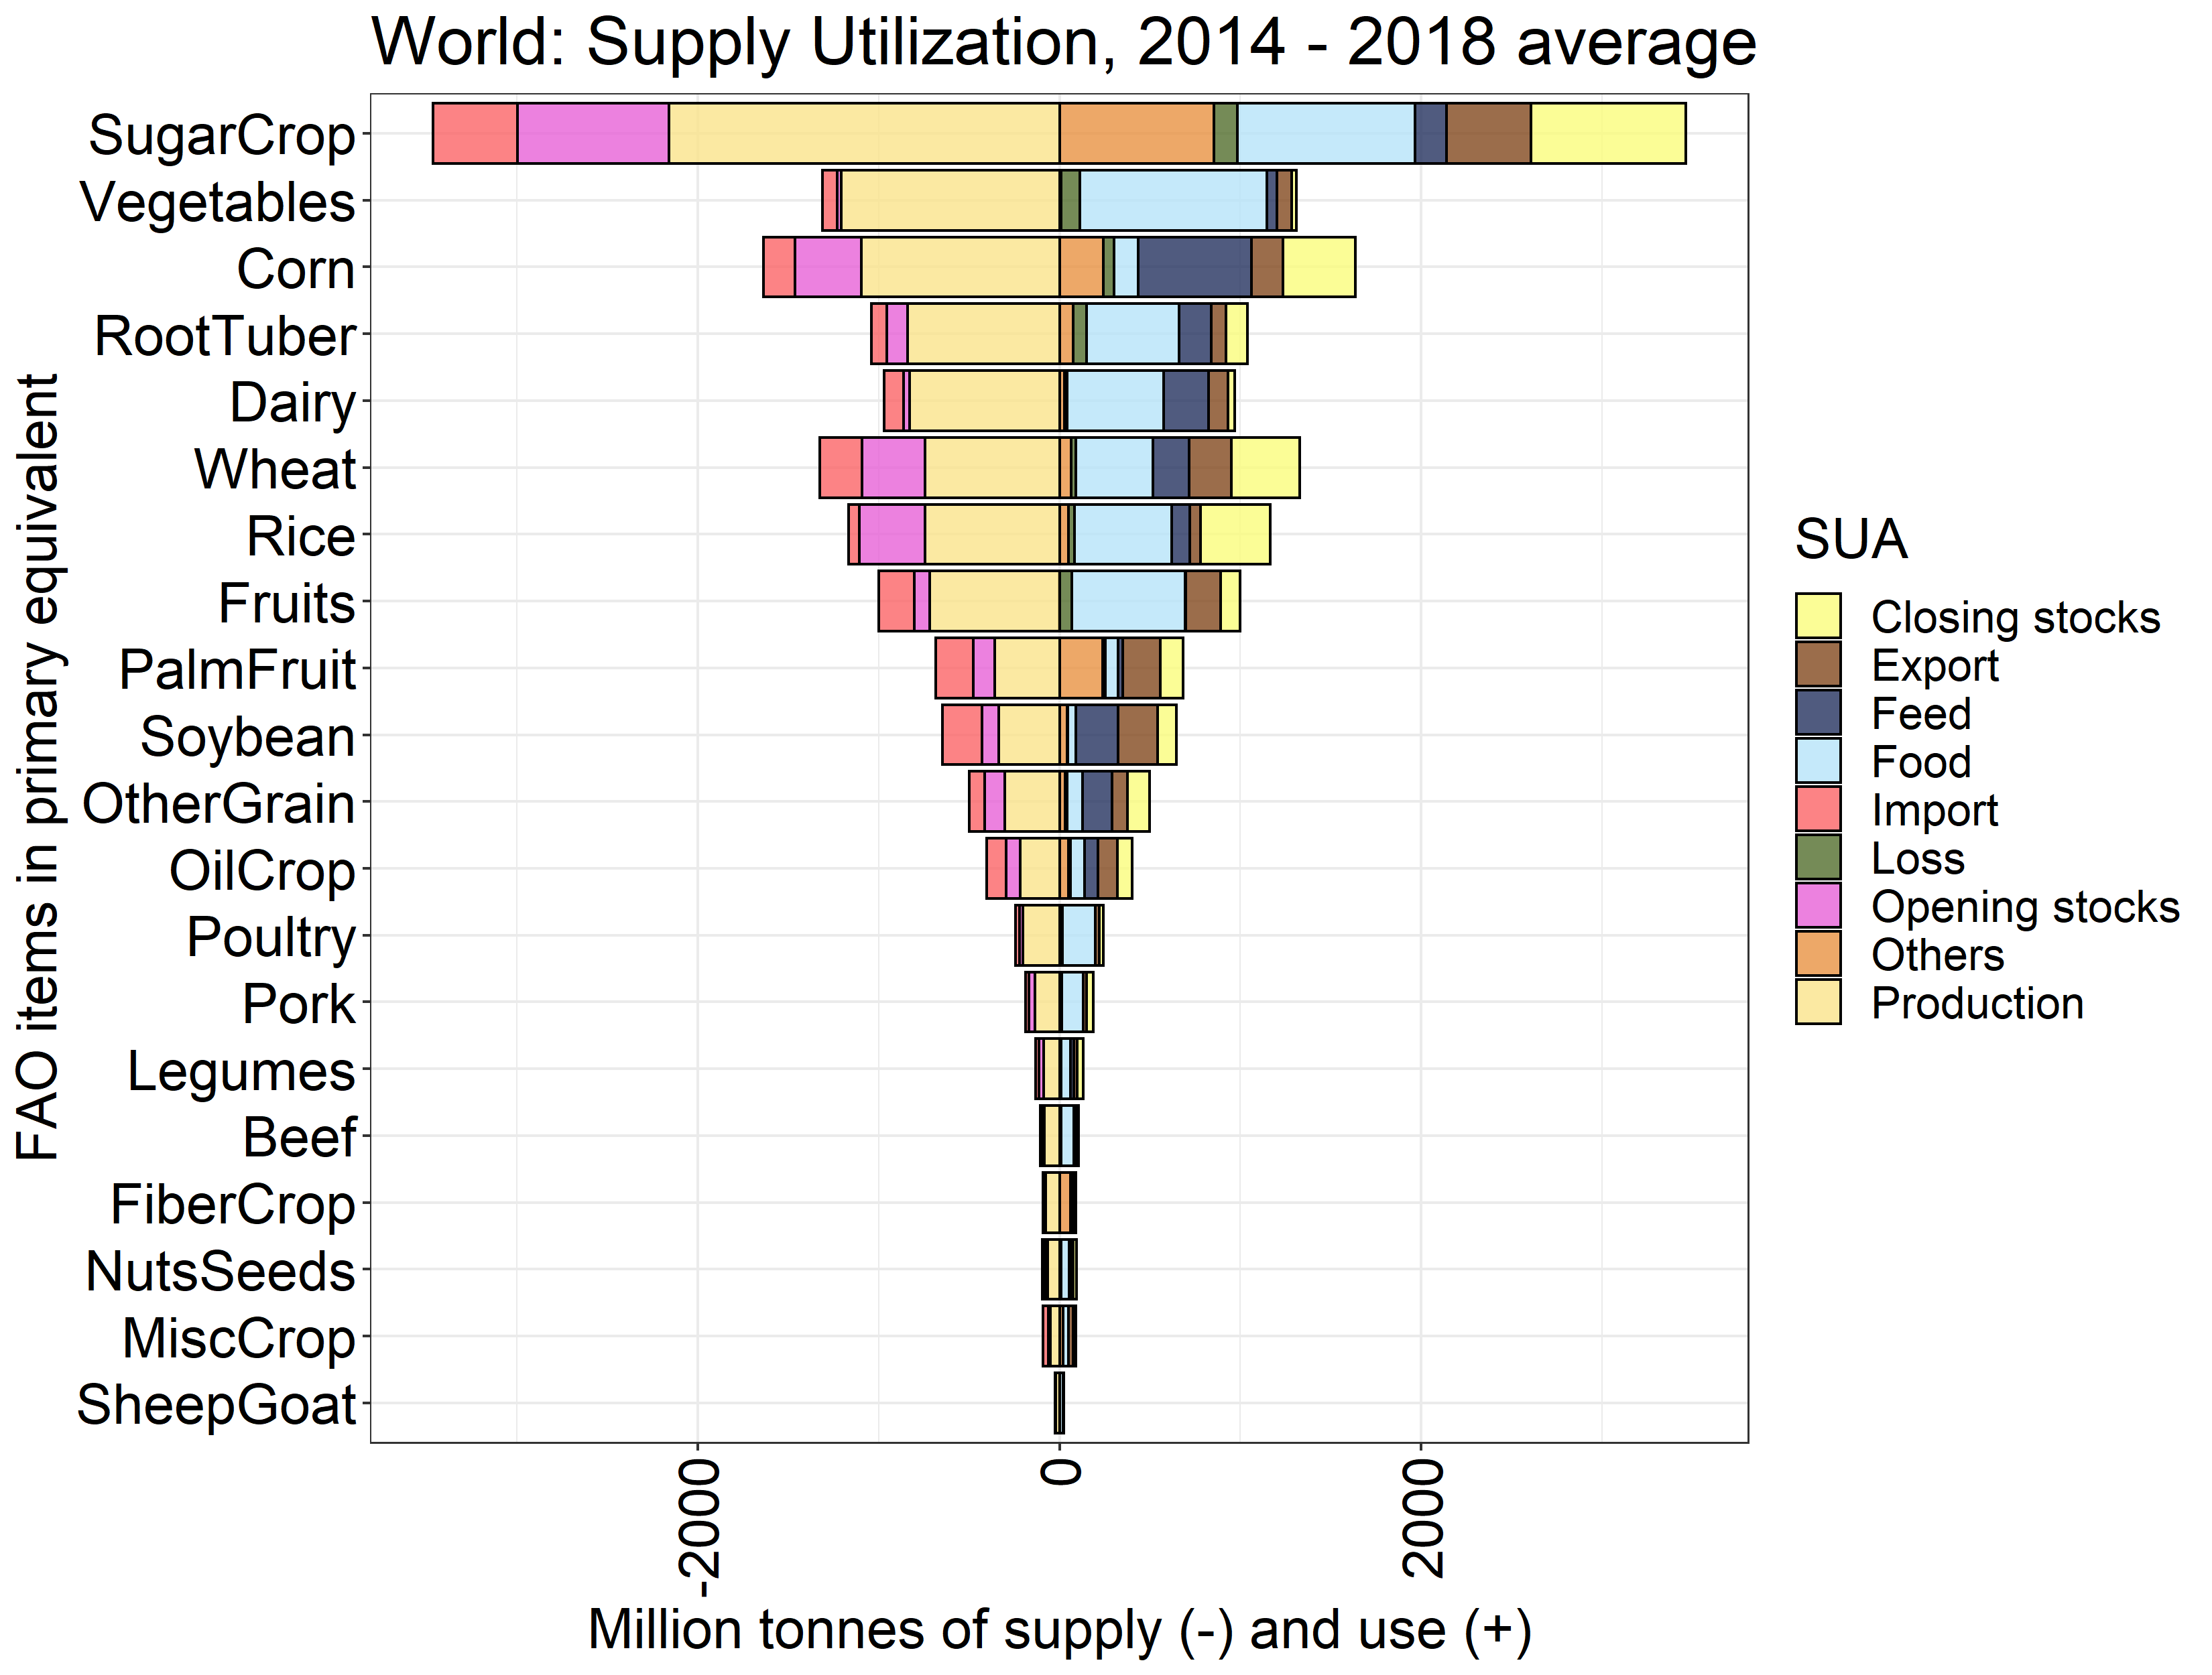
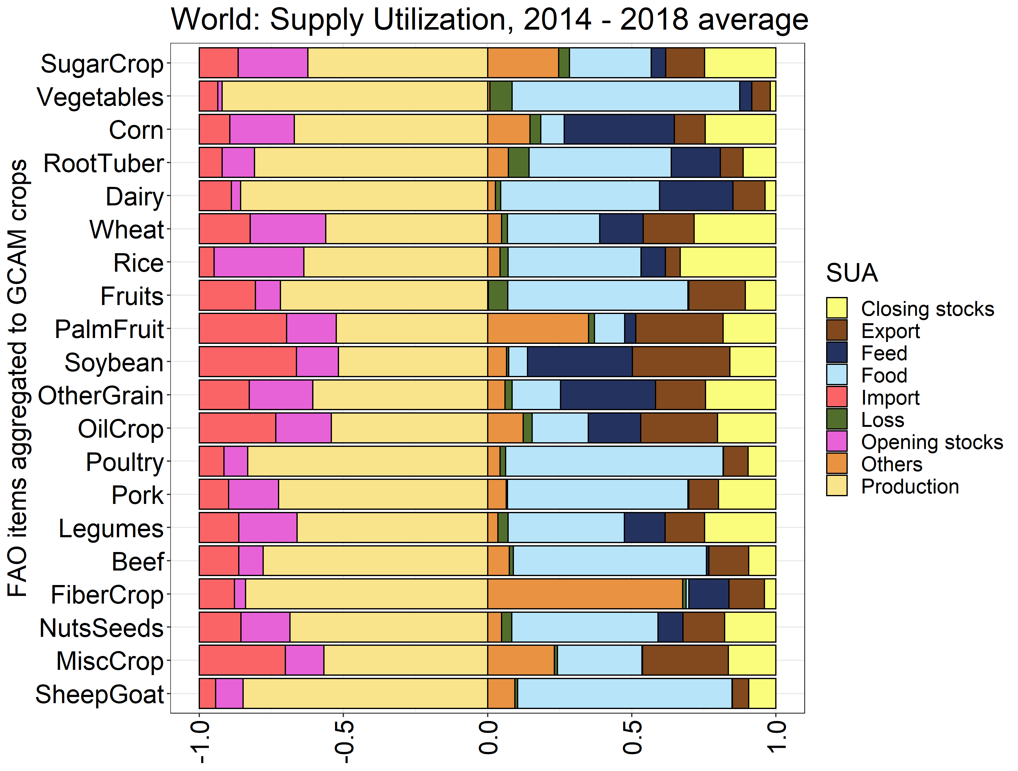
New FAO data

Slide 46
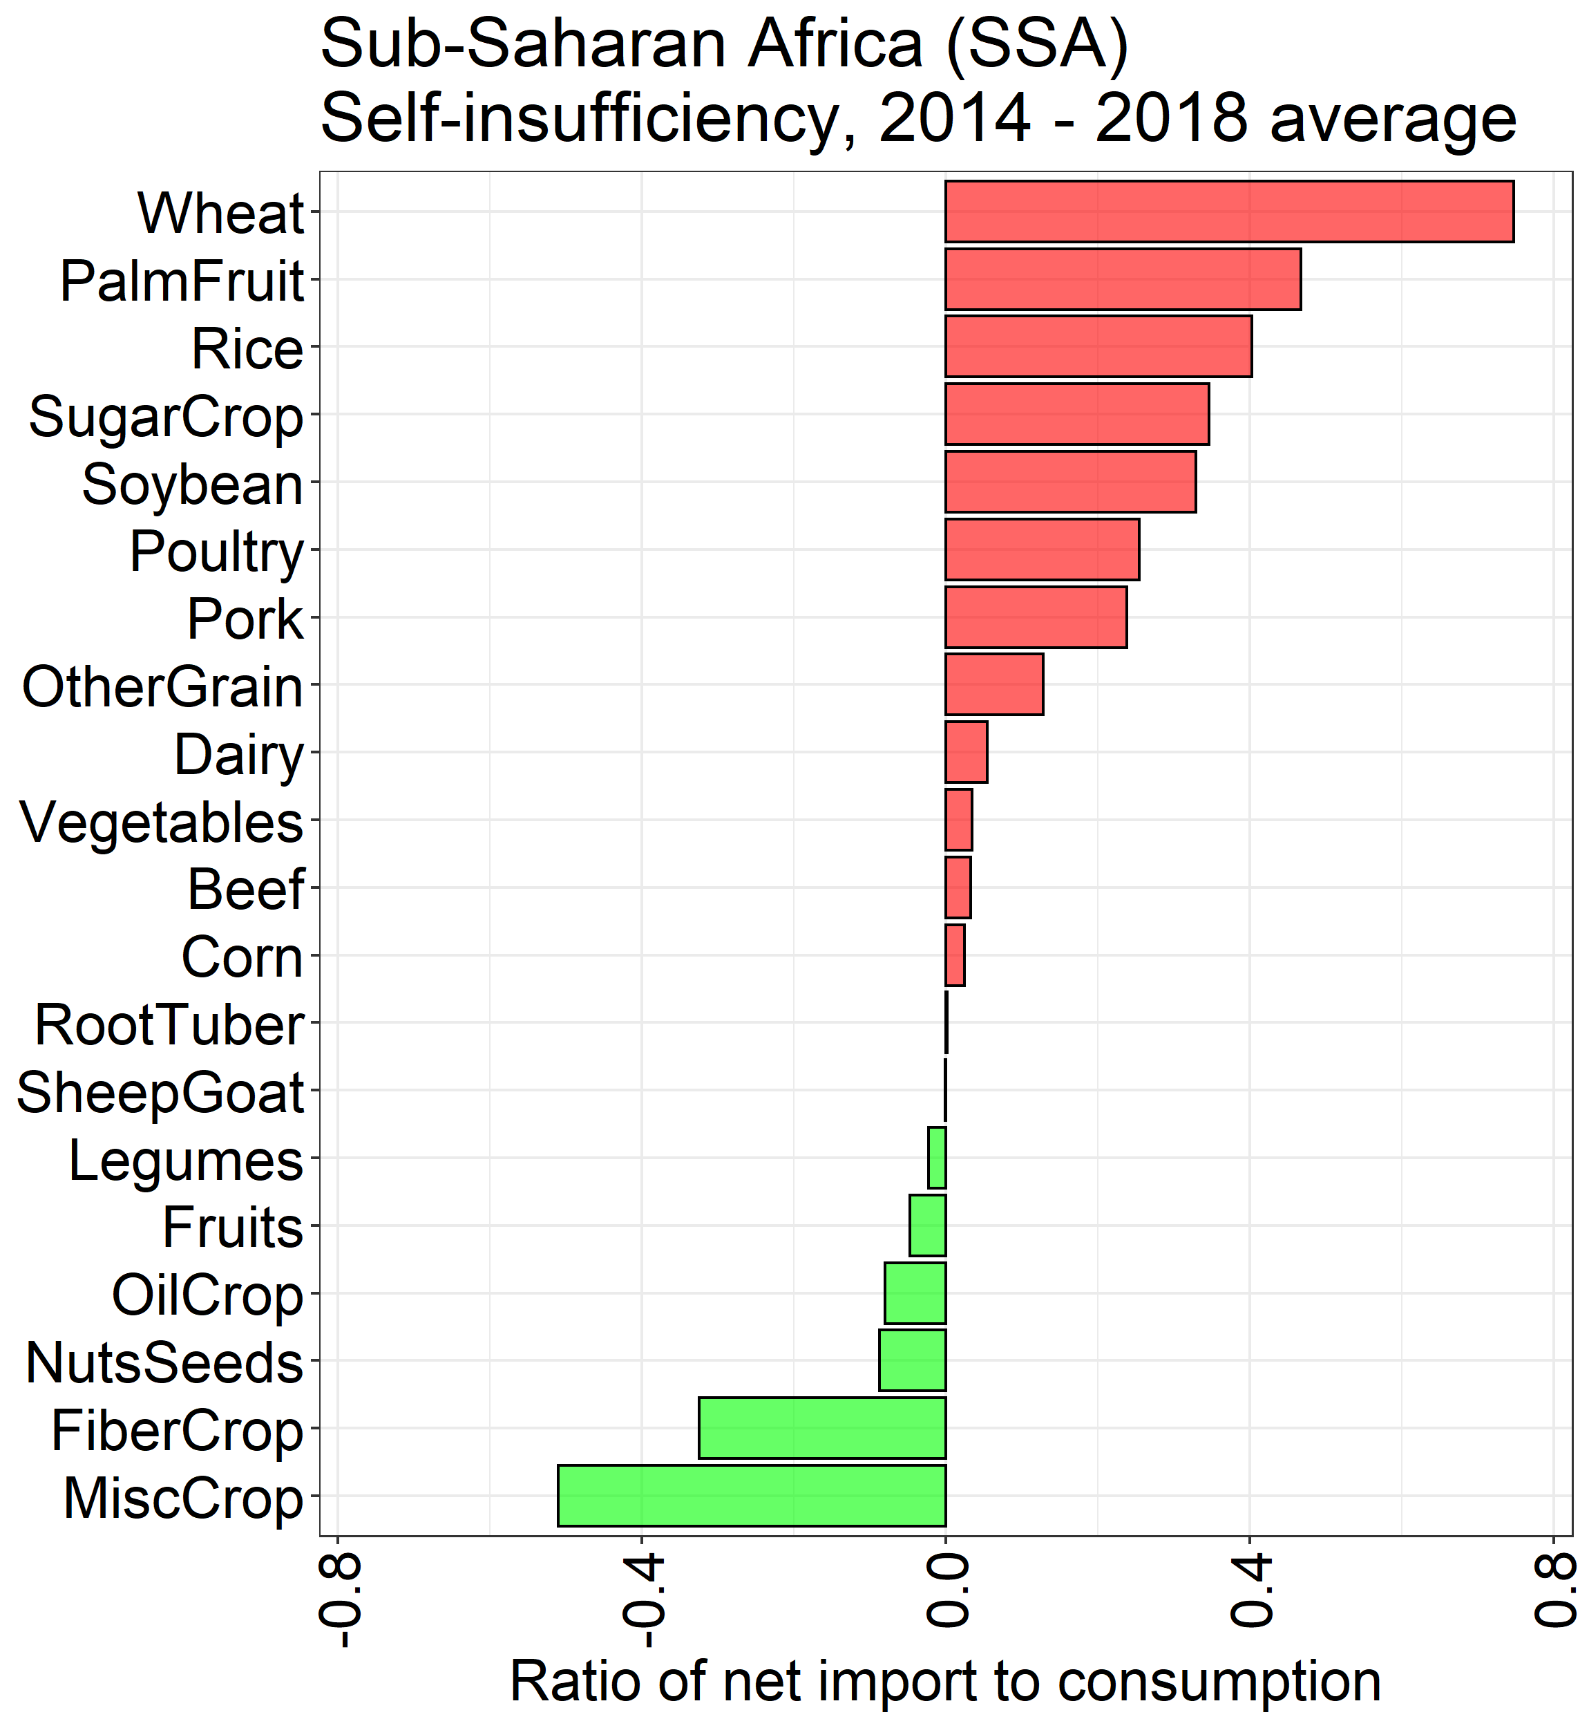
Self-sufficiency

Slide 47
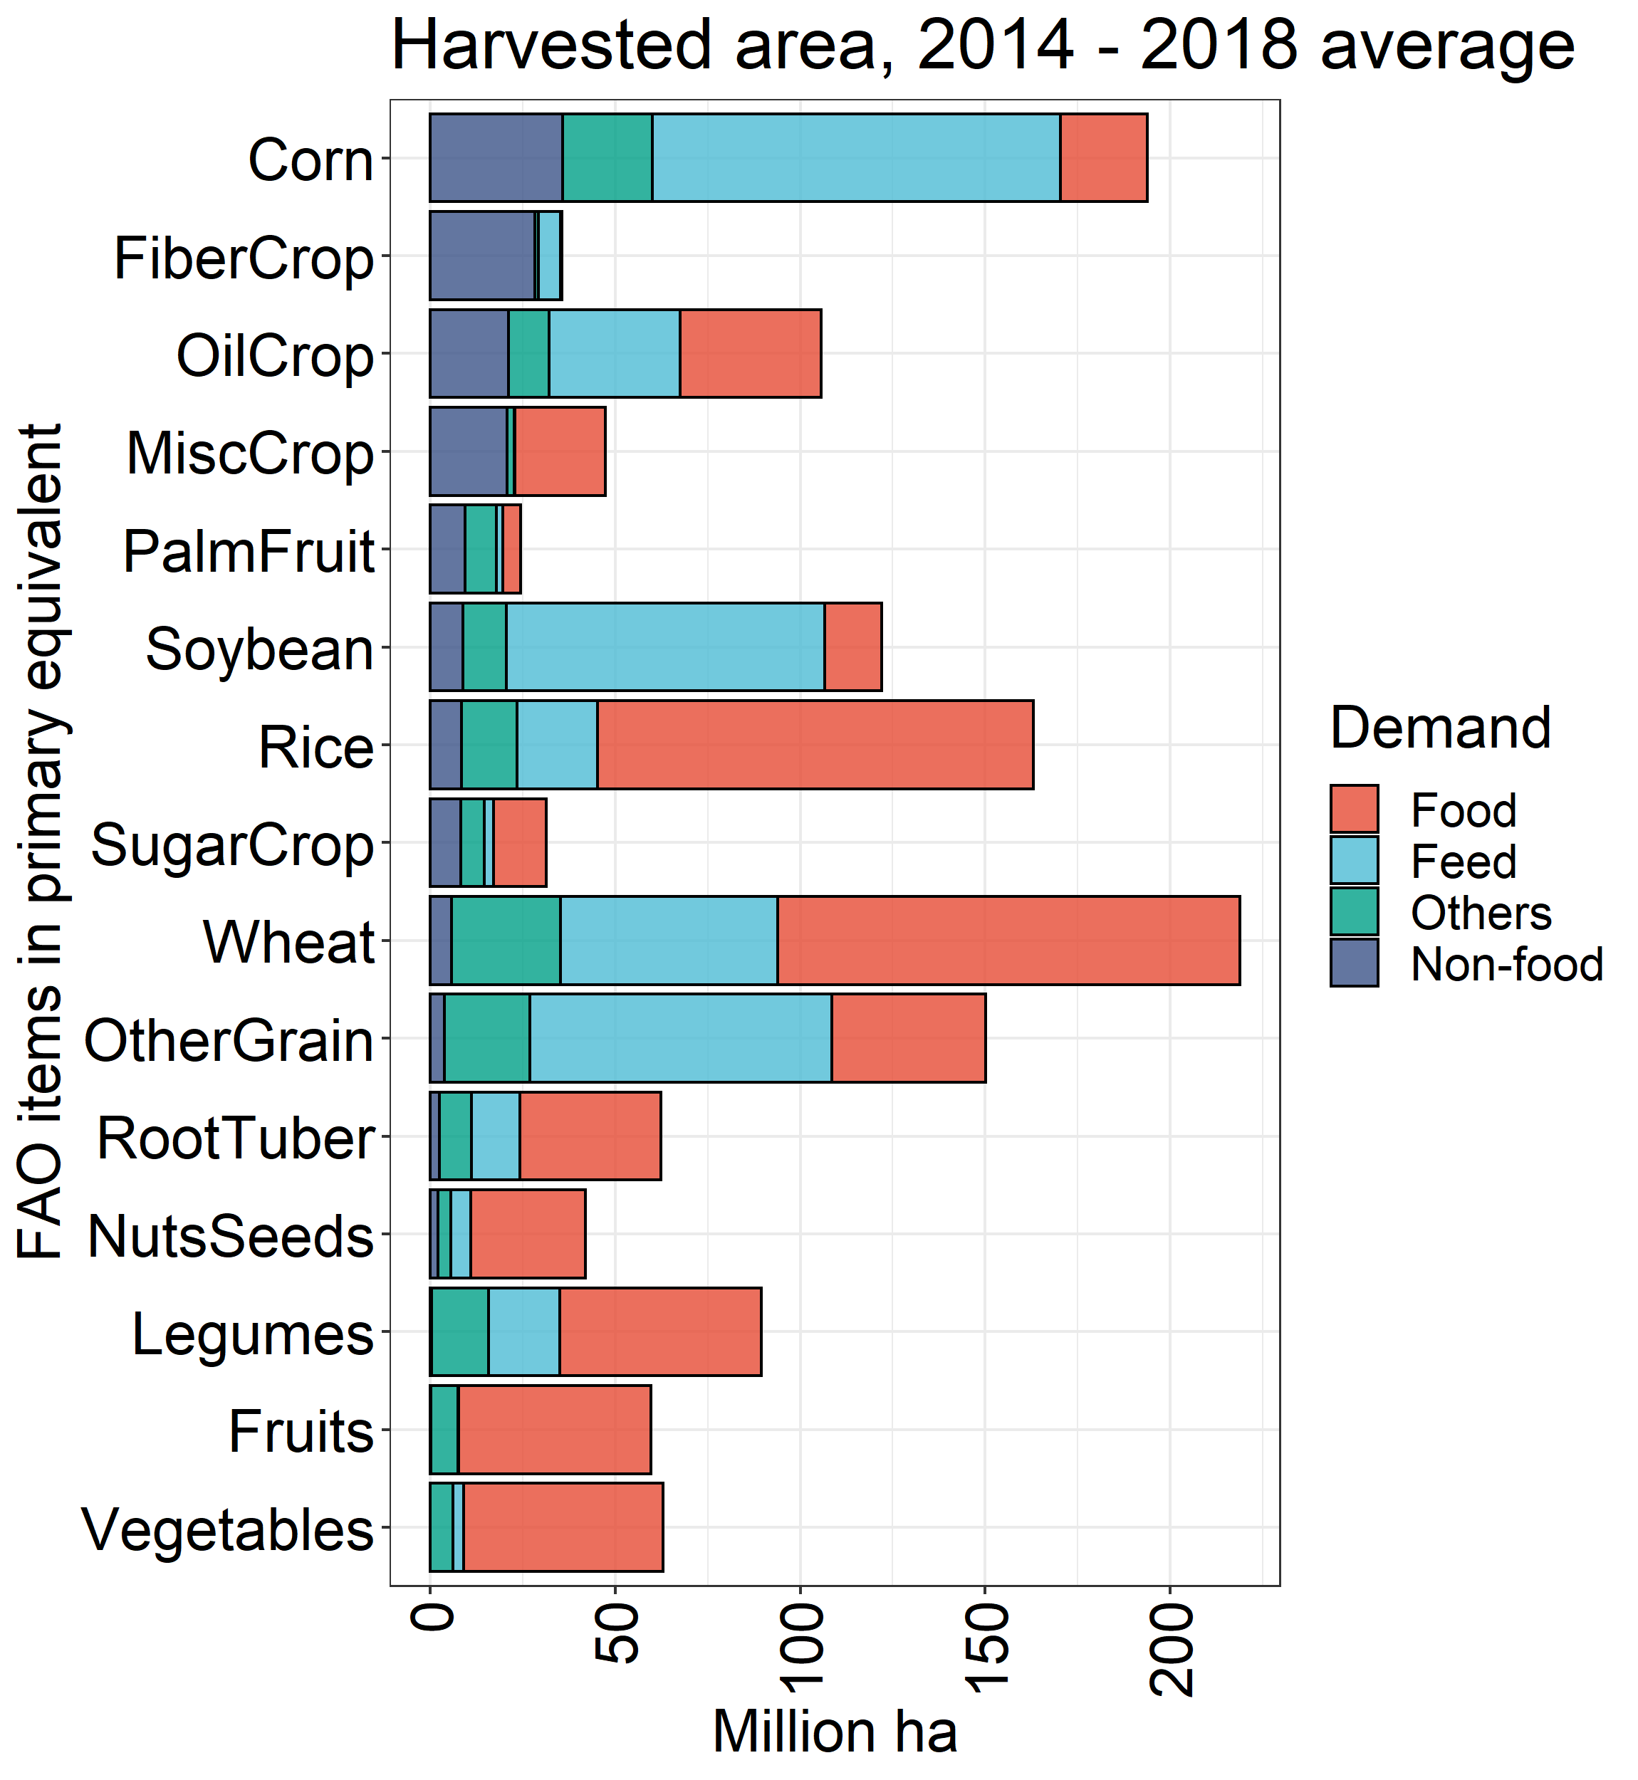
Global harvested area by use

Slide 48
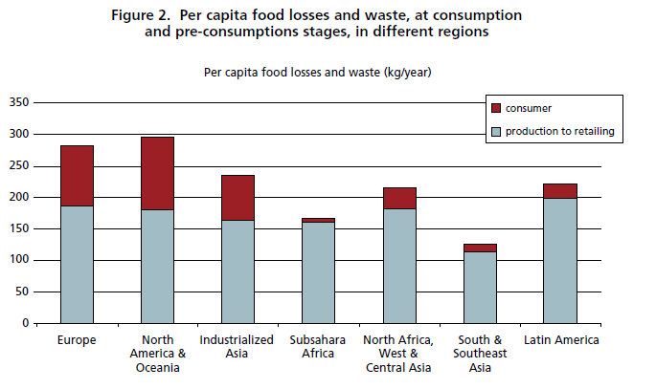
Food waste vs. food loss
Food Waste
Post-harvest crop losses
FAO

Slide 49
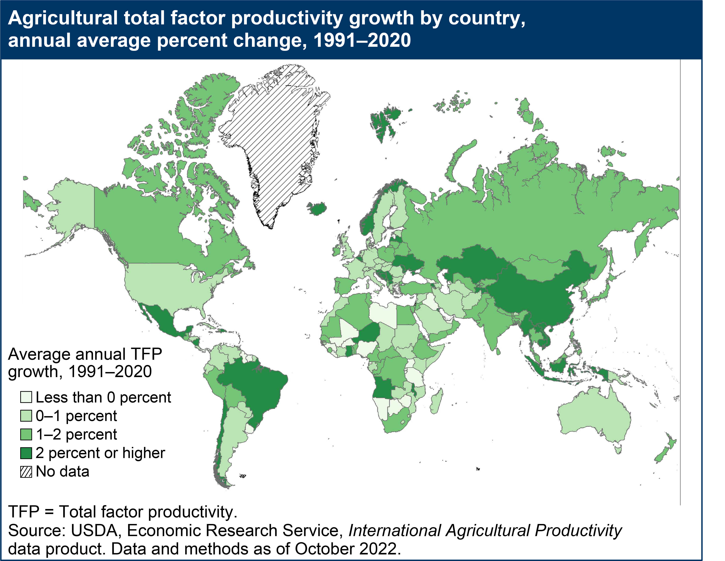
TFP growth
USDA (2022)

Slide 50
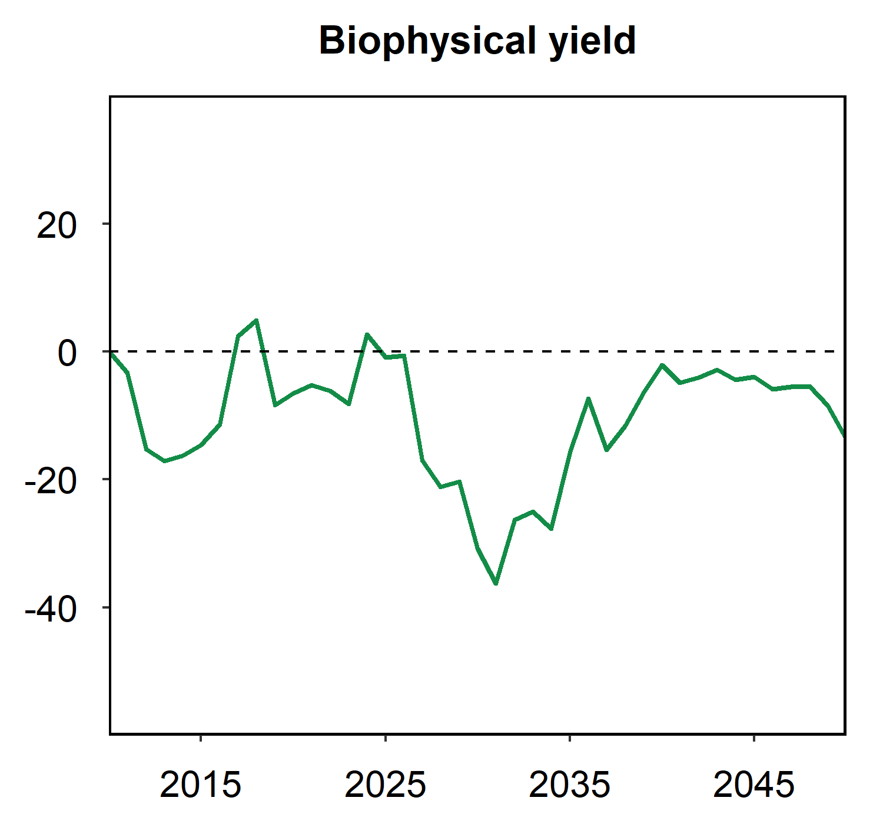
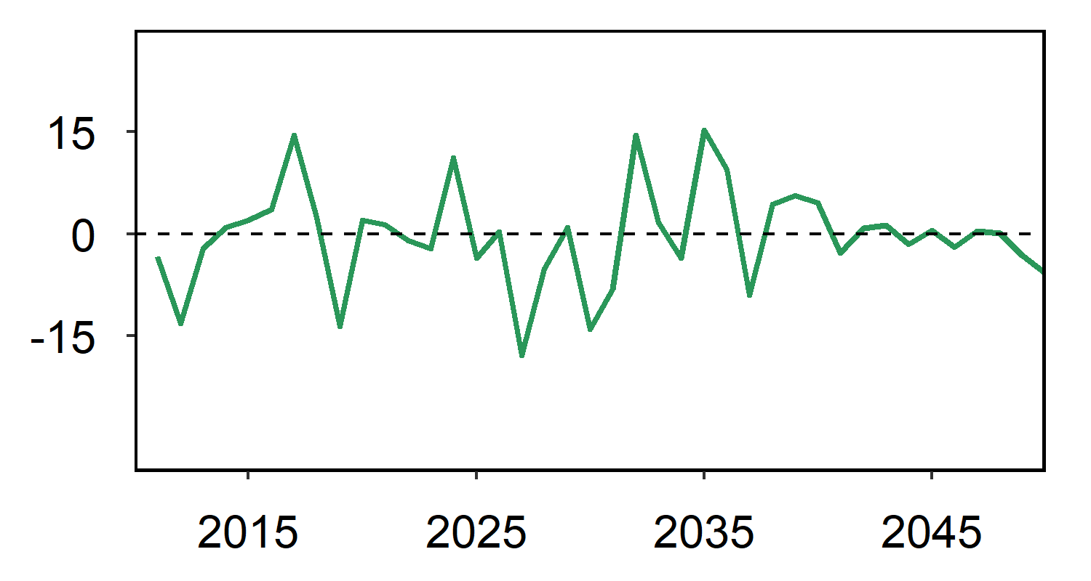
Biophysical yield shocks
A high-emissions scenario
RCP8.5 & GFDL-EPIC
Interannual variability
SD of annual percent change
US oil crop (soybeans): 7.4%
Climate vs. no climate (%)
-14%
US oil crop
(soybeans)
Interannual (%)

Slide 51
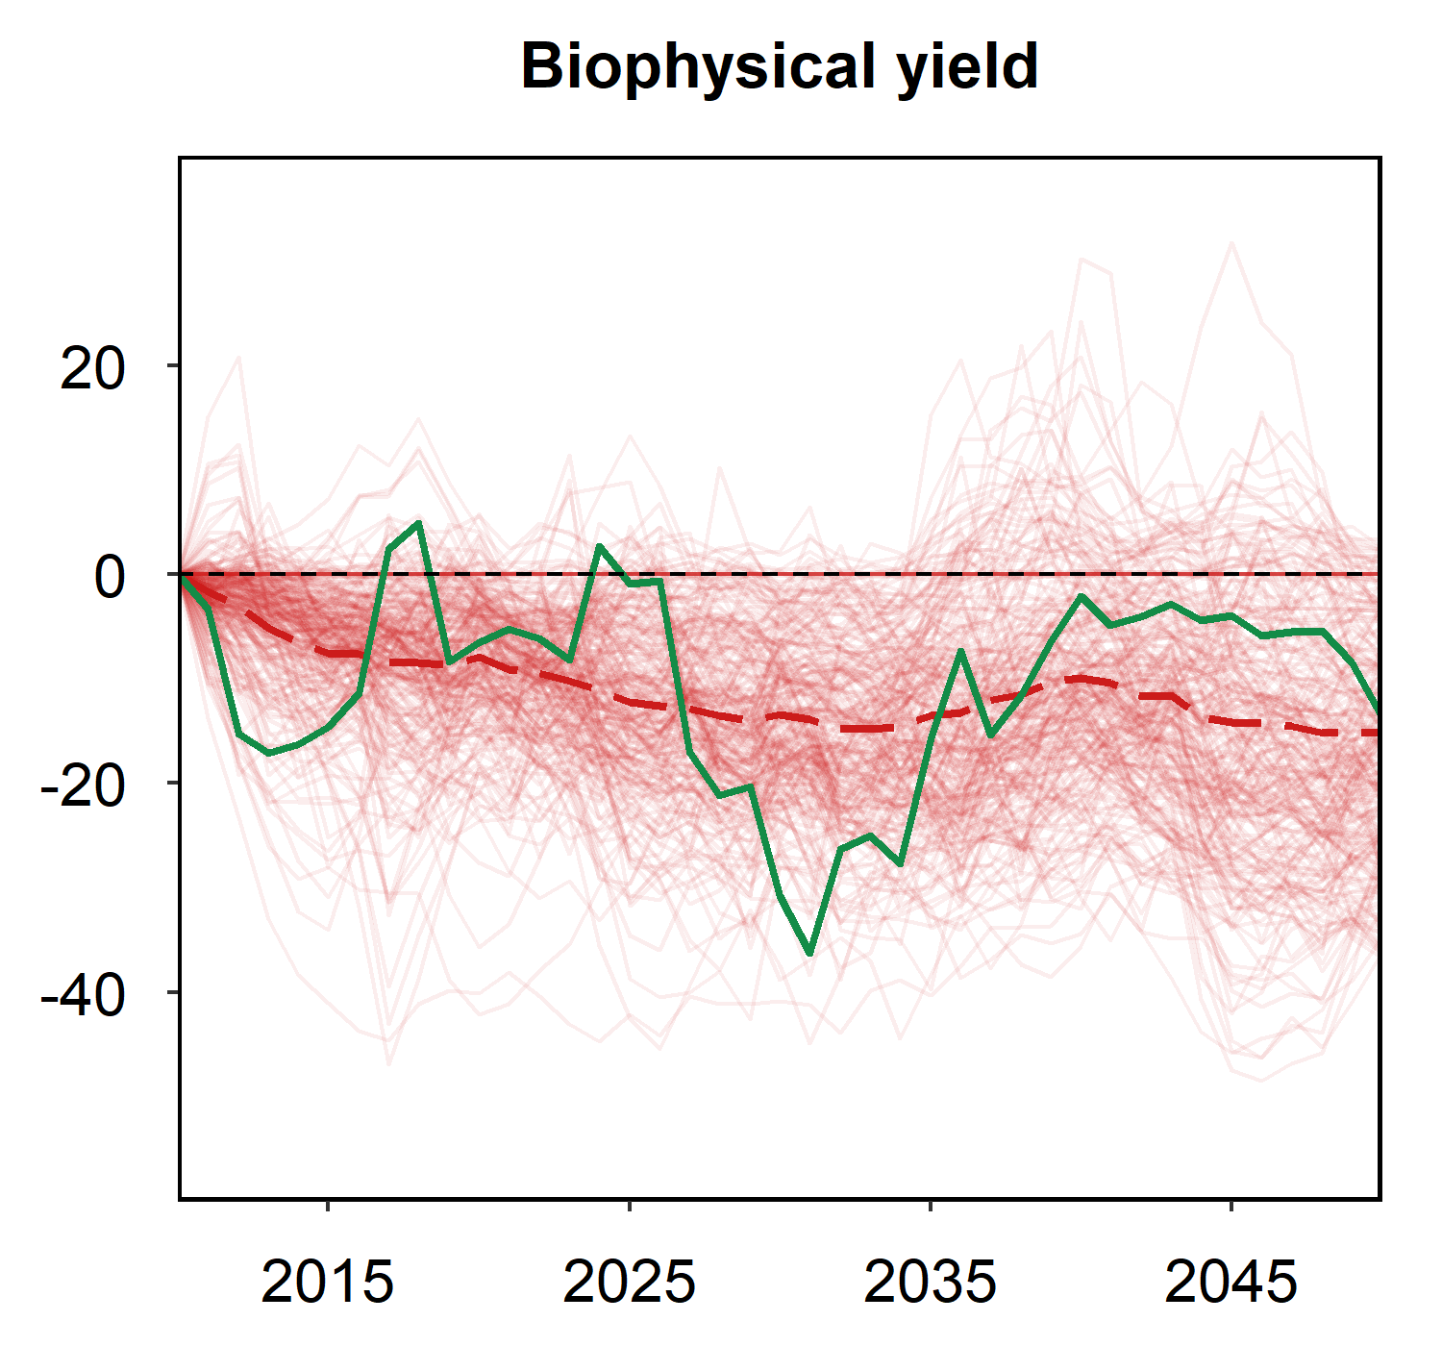

Biophysical yield shocks
A high-emissions scenario
RCP8.5 & GFDL-EPIC
Interannual variability
SD of annual percent change
US oil crop (soybeans): 7.4%
World: 4%
Other
region-crops
Climate vs. no climate (%)
-14%
World
average
-15%
US oil crop
(soybeans)
7.4%
Interannual (%)
4.0%

Slide 52


Climate impacts on agriculture Original GCAM results
Other
region-crops
World average
Climate vs. no climate (%)
Climate vs. no climate (%)
World
average
US oil crop
(soybeans)
US oil crop
(soybeans)
7.4%
Interannual (%)
4.0%

Slide 53




Climate impacts on agriculture Run GCAM annually
Other
region-crops
World average
Climate vs. no climate (%)
Climate vs. no climate (%)
World
average
US oil crop
(soybeans)
US oil crop
(soybeans)
7.4%
Interannual (%)
Interannual (%)
4.0%

Slide 54




Climate impacts on agriculture Run GCAM annually + all region-crops
Other
region-crops
Other
region-crops
Climate vs. no climate (%)
Climate vs. no climate (%)
World
average
US oil crop
(soybeans)
US oil crop
(soybeans)
7.4%
US oil crop
(soybeans)
0.9%
4.5%
Interannual (%)
Interannual (%)
World
average
4.0%
1.3%
4.4%

Slide 55


Climate impacts on agriculture Adaptive expectations
Imperfect foresight
Smaller variation for area
Slower adaptation
Effectively more rigid acreage responses
Higher price volatility
Endogenous market fluctuation
0.2%
6.4%
Adaptive expectation
Interannual (%)
0.6%
10.6%
7.4%
US oil crop
(soybeans)
0.9%
4.5%
Interannual (%)
Perfect foresight
Interannual (%)
World
average
4.0%
1.3%
4.4%

Slide 56

Teleconnected grain markets
2020 Wheat trade
Price transmission in international grain markets
FAOSTAT; Zhao (2022); Rennison (2022);

Slide 57

Land: Past Trends and Current Status
Source: IPCC SRCCL SPM

Slide 58

Land Systems at Risk from Climate Change
Source: IPCC SRCCL SPM Figure 2

Slide 59

Different types of land use decision-making
Source: Malek and Verburg (2020). https://doi.org/10.1016/j.gloenvcha.2020.102170
Notes:
Hard to represent institutional and behavior changes, particularly in an IAM

Slide 60

Different estimates of land cover
Source: Meiyappan and Jain (2012). 10.1007/s11707-012-0314-2

Slide 61

Lots of site-specific information, but globally consistent data sets harder
Source: Davis et al. (2013). 10.1111/gcbb.12042
Notes:
Also note gaps in driver data (like cost, subsidy, etc.)

Slide 62
Strengths of IAMs
Long-term
Interconnection with other systems
Interconnection with other regions
Emission trade-offs
Help to answer what if questions

Slide 63
Learning from historical simulations within our own model.
Lesson #1: Overall, GCAM doesn’t do that poorly.
Calvin et al. (2017)

Slide 64
Learning from historical simulations within our own model.
Lesson #2: GCAM can’t predict policy.
Calvin et al. (2017)

Slide 65
Learning from historical simulations within our own model.
Lesson #3: We do better at trends than inter-annual variability.
Calvin et al. (2017)

Slide 66
Learning from historical simulations within our own model.
Lesson #4: We tend to over-compensate for yield fluctuations.
Calvin et al. (2017)

